Slide 1
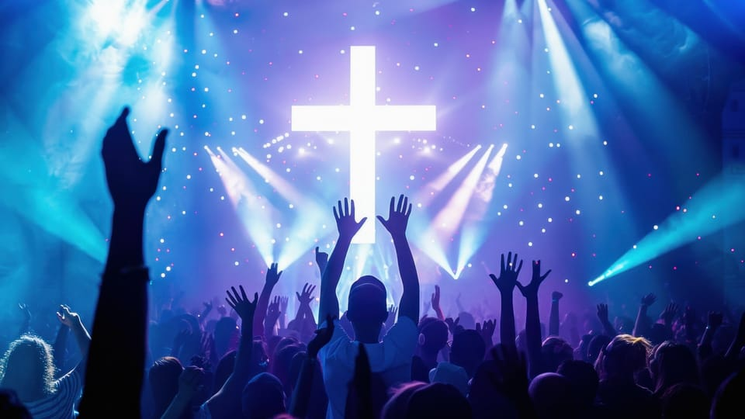
Worship

Slide 2
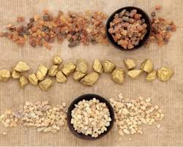
Matthew 2:1-12
Gold
A very precious metal that only royalty and the very rich can afford.
Frankincense
Used as a perfume and incense in temples.
Myrrh
A spice used in medicine and to anoint people for specific jobs

Slide 3
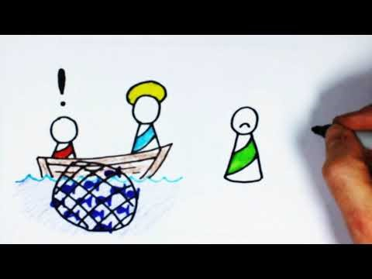

Slide 4

So here’s what I want you to do, God helping you: Take your everyday, ordinary life—your sleeping, eating, going-to-work, and walking-around life—and place it before God as an offering. Embracing what God does for you is the best thing you can do for him. Don’t become so well-adjusted to your culture that you fit into it without even thinking. Instead, fix your attention on God. You’ll be changed from the inside out. Readily recognize what he wants from you, and quickly respond to it. Unlike the culture around you, always dragging you down to its level of immaturity, God brings the best out of you, develops well-formed maturity in you.
Romans 12:1-2

Slide 5
How does doing this worship God?
2. Is this an everyday or once-a-week activity? If once-a-week, could it be an everyday worship option?
3. Has anyone worshipped in this way and found it helpful? How does it change your perspective upon God or the day you are in?

Slide 6


Slide 7


