Slide 1
Why did Jesus die?

Slide 2
The punishment fits the crime
A person who lies to their friend
A person leaves their room in a mess
A child who steals a penny sweet.
A person who cheats on their exams
A person who is caught speeding
A person who is caught drink driving
A person who kills someone because of drink driving
A person who kills a man
A person who disobeys God

Slide 3
Romans 3:23
Everyone has sinned and is far away from God’s saving presence

Slide 4
Romans 6:23
For sin pays its wage – death; but god’s free gift is eternal life in union with Christ jesus our lord.

Slide 5
John 3:16 Romans 3:23-26 2 Corinthians 5:21

Slide 6


Slide 7
Sin as a Virus
How is Jesus like a cure?
What does it mean that He was immune to sin?
How can we accept the cure?
How does knowing Jesus is the cure change the way we live?

Slide 8
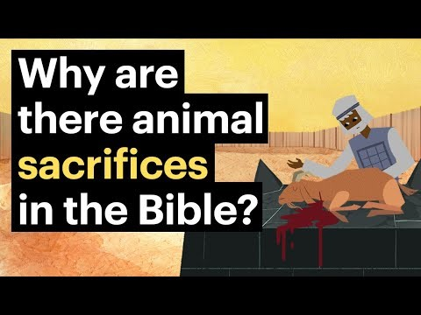

Slide 9

But God demonstrates his own love for us in this: While we were still sinners, Christ died for us. Romans 5:8

Slide 10
