Slide 1



Slide 2
What’s in the bags?

Slide 3

For God so loved the world that he gave His only Son, so that everyone who believes in him may not die but have eternal life.
John 3:16

Slide 4

To be our Rescuer
Jesus Came

Slide 5
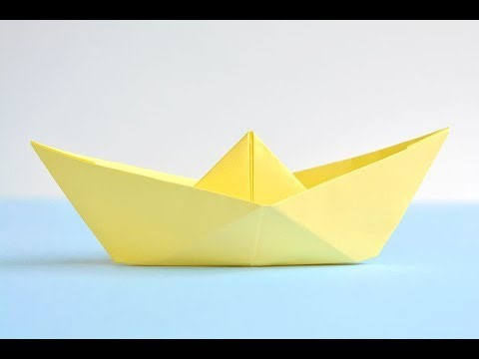
Origami Boat
https://vimeo.com/119647207?fl=pl&fe=sh
John 13:13-15 ‘I have set an example for you so that you will do just what I have done for you.’

Slide 6
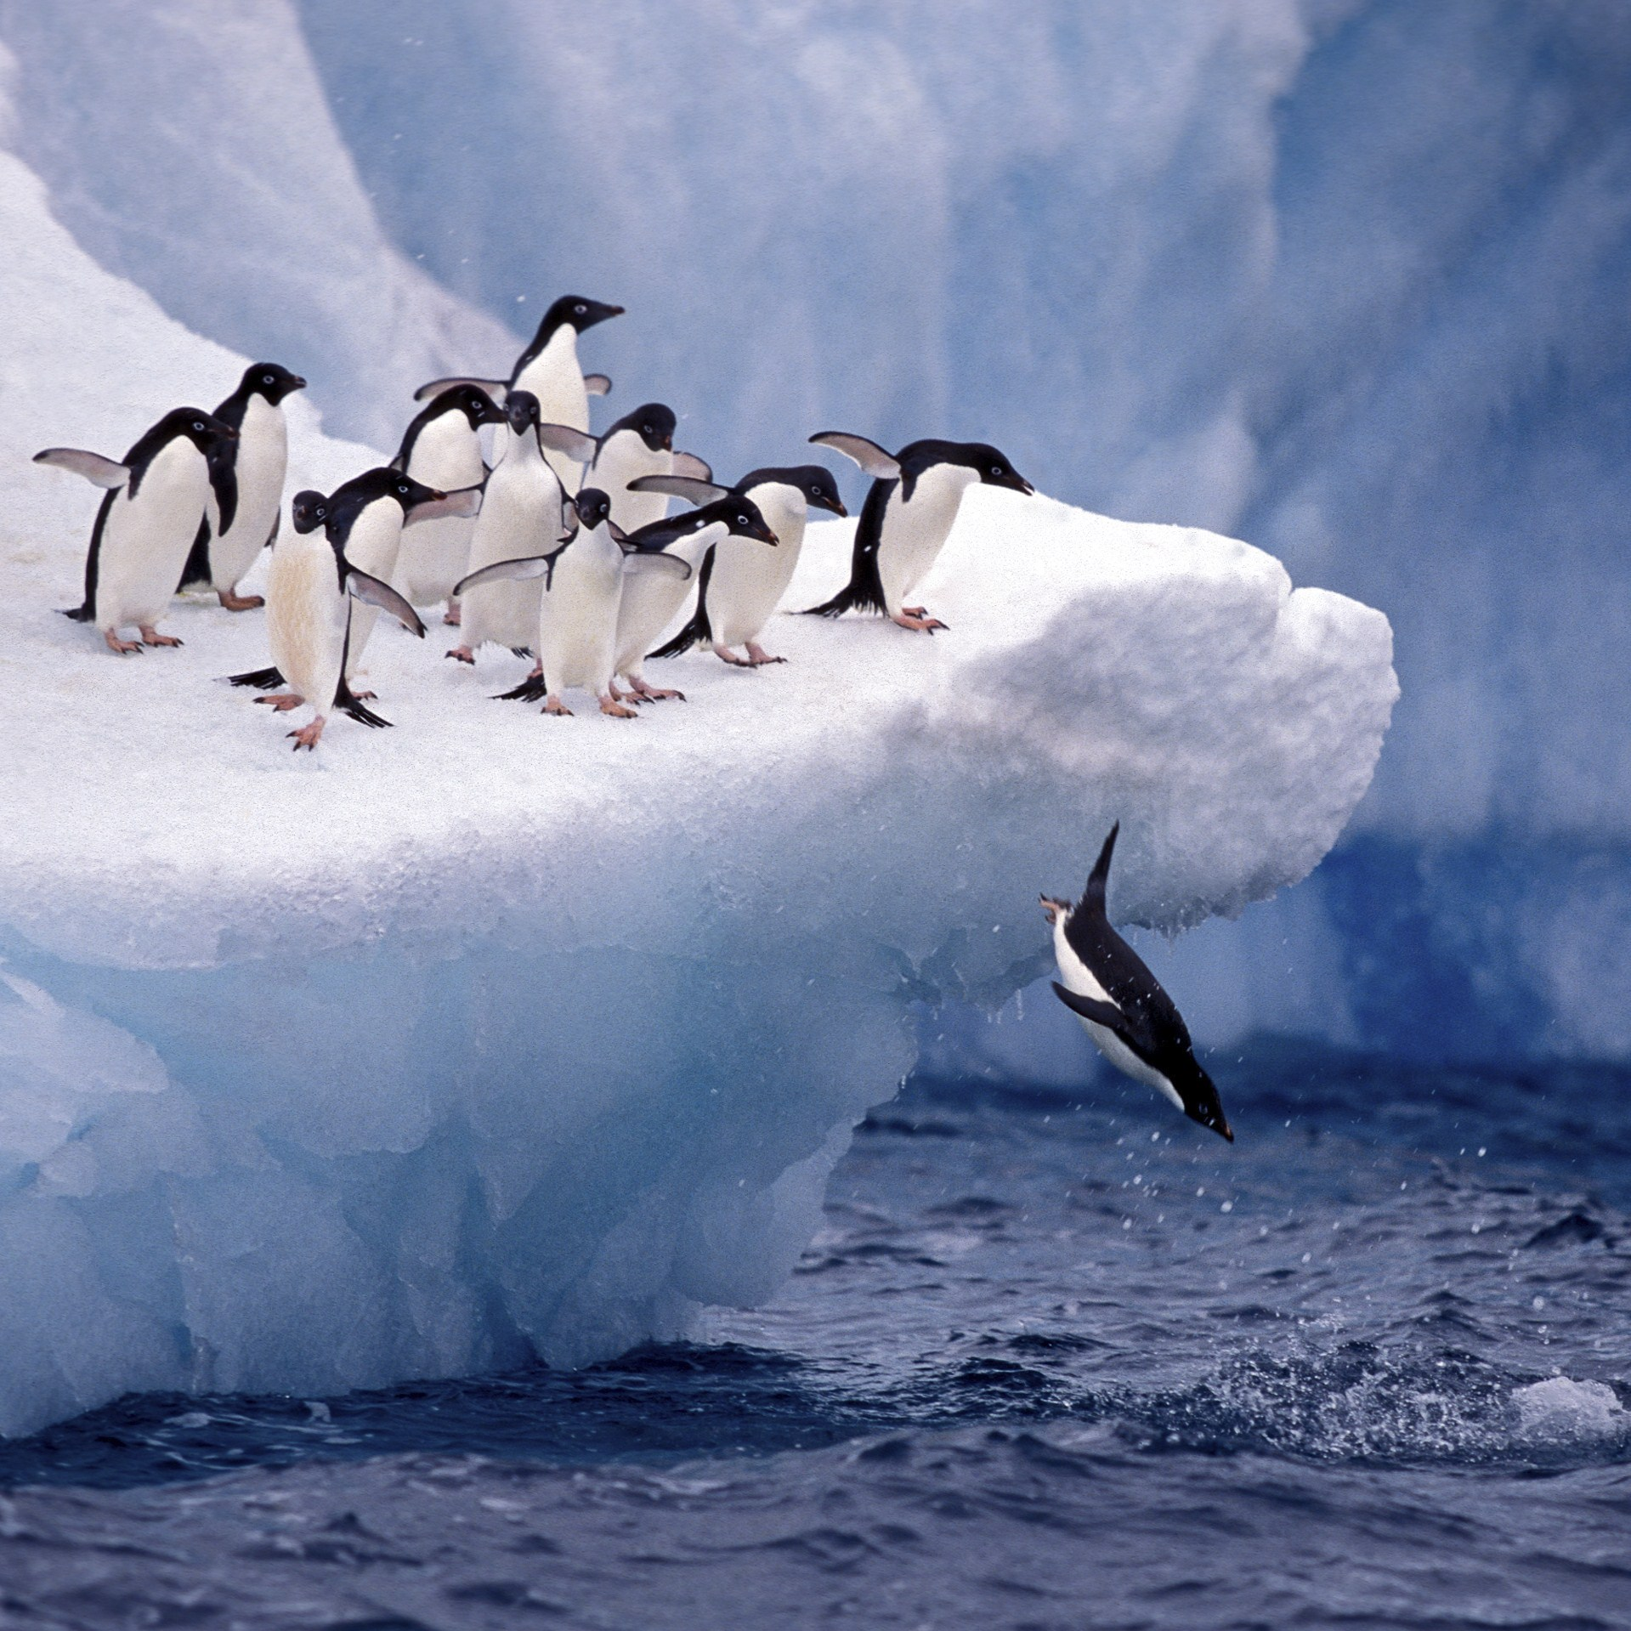

To be our Rescuer
To be an example
Jesus Came

Slide 7
If God came to visit….
John 8:1–11
Luke 5:12–13
Mark 4:35–41
How does what you read in these passages compare to what your test for God was?

Slide 8
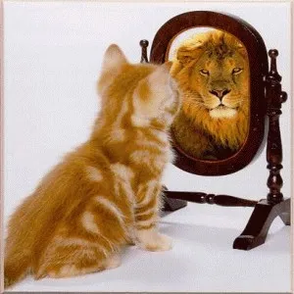
To be our Rescuer
To be an example
Jesus Came
To show us what God is like

Slide 9
Luke 22:44
Matthew 4:1–11
What are our struggles?
John 11:33–36
Luke 22:48–49
John 1:10–11

Slide 10
And now He can help those who are tempted, because He himself was tempted and suffered.
Hebrews 2:18
Our High Priest is not one who cannot feel sympathy for our weaknesses. On the contrary, we have a High Priest who was tempted in every way, but did not sin. Let us have confidence, then, and approach God’s throne, where there is grace. There we will receive mercy and find grace to help us just when we need it.
Hebrews 4:15-16

Slide 11

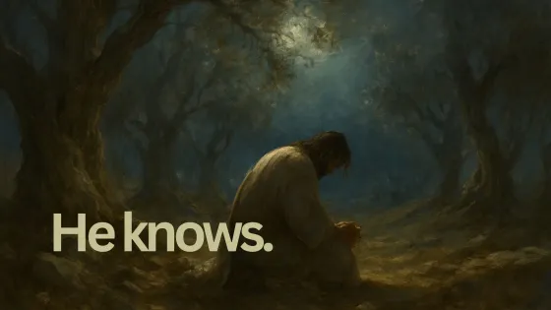
To be our Rescuer
To be an example
Jesus Came
To show us what God is like
To understand our suffering

