Slide 1

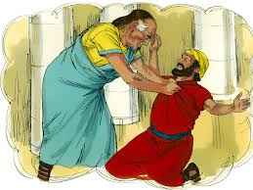
The parable of the unmerciful servant.
Matthew 18:21-35

Slide 2
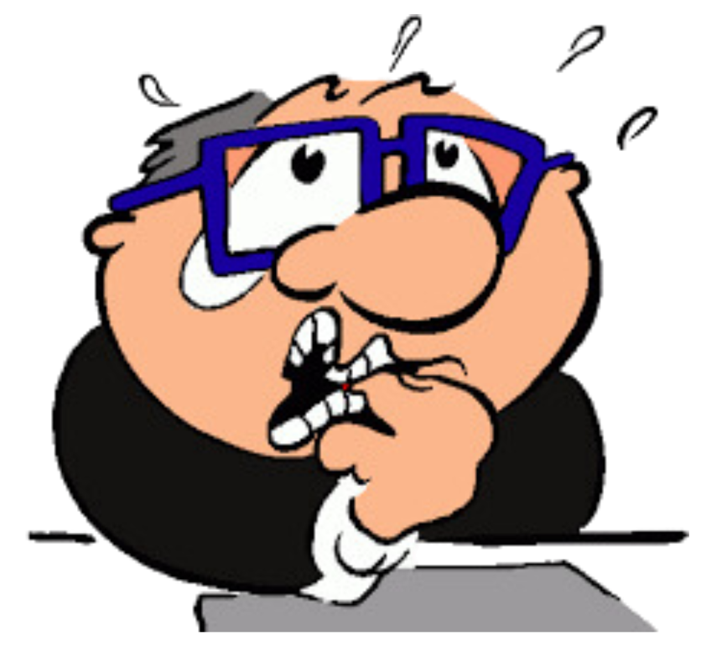

Let’s play
How forgiving are you?

Slide 3
Would you forgive if…
A friend snatches your mobile and accidently drops it. It breaks!
A mate a t school tells lies about you. You get picked on as a result.
A sibling steals your favourite jumper and rips it when using it.
A parent or someone you love is injured by a careless driver.
A parent does something awful which causes you stress and pain.
You are cheated out of a lot of money by someone you trusted.

Slide 4

Cheesy video
Activity 1
Read Matthew 18:21-35

Slide 5
1. What do you think of Peter’s question in v21
2. Do you feel like Peter, that forgiveness should be limited to only a few times?
3. Are some things easier to forgive than others?
4. What do you think of Jesus’ response?
5. What do we learn about human nature and God’s nature from these verses?
Activity 1
NB: Text could mean 77 times or 7x70 which is 490!

Slide 6
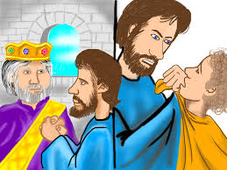
Who are the characters and what can we learn?
Activity 2
1. Who is God in the story? What is he like? (merciful, just– deals with the unmerciful servant)
2. Who is the servant? What is he like? Is he like us?
3. Who does the other servant represent? The one who got choked!

Slide 7

Who are the characters and what can we learn?
Activity 2
How would you sum up the key message of the story. Talk to the person next to you. Explain it to them.
Get them to explain it to you.
Be prepared to feed back

Slide 8
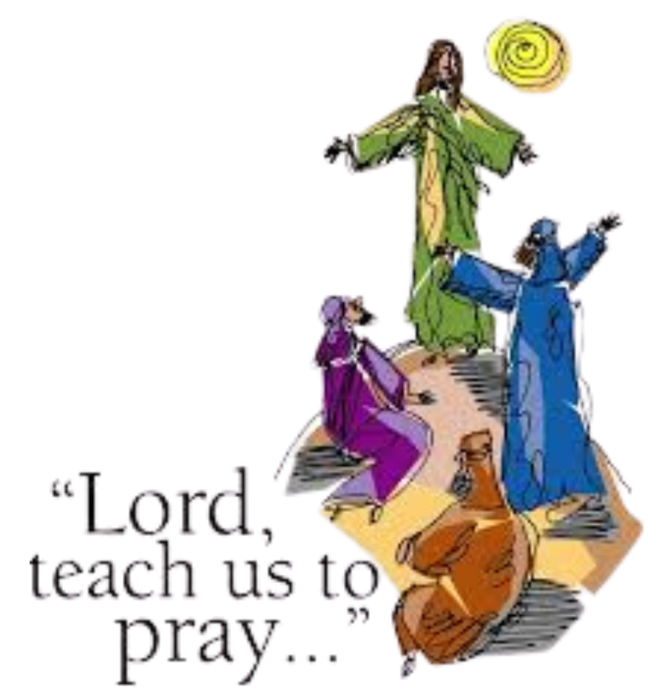
Who can recite the Lord’s prayer?
Activity 3

Slide 9
Activity 3
1. Which part relates to the parable?
2. What does it mean “forgive those who sin against
us”?
3. What does forgiveness look like? Is it more than just
words?
4. Does forgiveness mean we forget about
justice?
5. Why must we forgive others ?
See Matt 6:v14 15

Slide 10
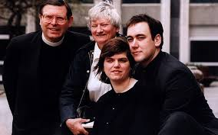

Stories of forgiveness
Activity 4
The Rev Michael Saward and Jill Saward
Natasha and Nadim Ednan-Laperouse
Jill Saward speaks of forgiveness

Slide 11
