Slide 1
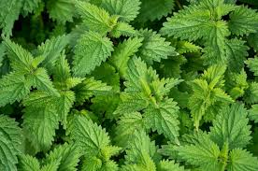
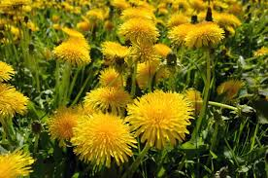
The Parable of the Weeds
Matthew 13:24-30

Slide 2
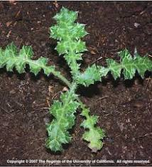
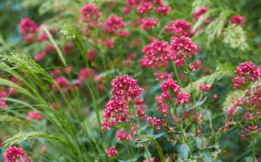
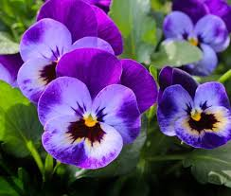
Let’s play… weed or flower?
Weed
Weed
Flower

Slide 3
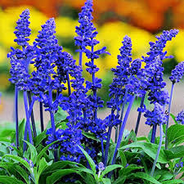
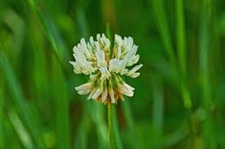
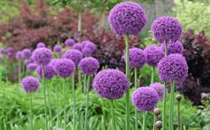
Flower
Weed
Flower
Weed
Flower

Slide 4
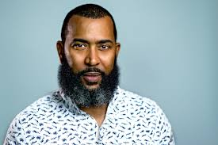
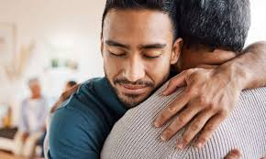
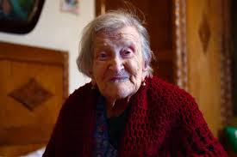
How about these? Can you tell who is good or bad?

Slide 5
Activity 1
Let’s read: Matthew 13:24-30
Cheesy video of the parable

Slide 6
Match up!
Activity 1
On your sheet match up the images with the words to create an explanation for the parable

Slide 7
Stay engaged or hide away?
Activity 2
Some Christian monks and nuns, and other Christian communities separate themselves from the world and do not engage fully with it.
Is this good or bad?
What are the dangers and benefits of both ways of living?
What does the Bible say?
Romans 12:2, John 16:33, Ephesians 2:10, 1 John 2:15-17

Slide 8
What really annoys you?
Activity 3
What sort of people get on your nerves?
What beliefs and values that people hold are different than yours?
What do you understand by the word tolerance?

Slide 9
Activity 3
Tolerance is NOT accepting every belief and view there is but it IS being patient, loving and accepting of people who are different in their thinking and lifestyle.
Look up: Matthew 5:43-48
What does Jesus teach us about living with people?

Slide 10
Are you weed or wheat?
Activity 4
Jesus said He WILL come back and take His people home to heaven. ( Harvest!)
Those who do not believe in him are destined for separation from heaven for ever in Hell.
Have you given your life to Jesus and repented of your sin?
Are you following Him every day? Do you love Jesus? Do you obey His commands?

Slide 11
A time of quiet prayer or asking questions?
Activity 4

