Slide 1
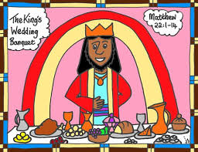
The Parable of the Wedding Feast. Matthew 22:1-14

Slide 2
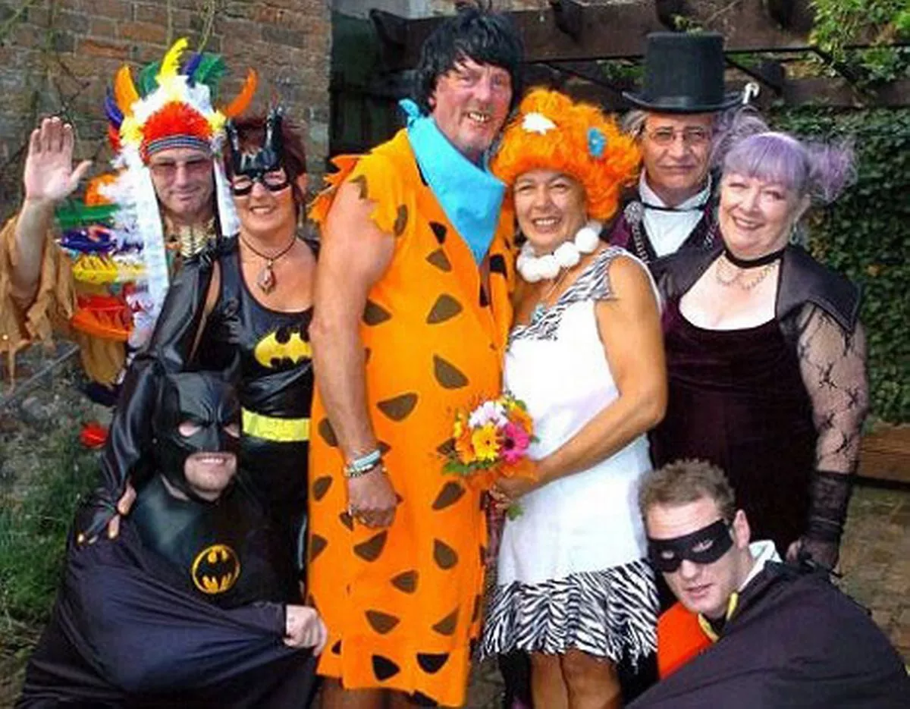
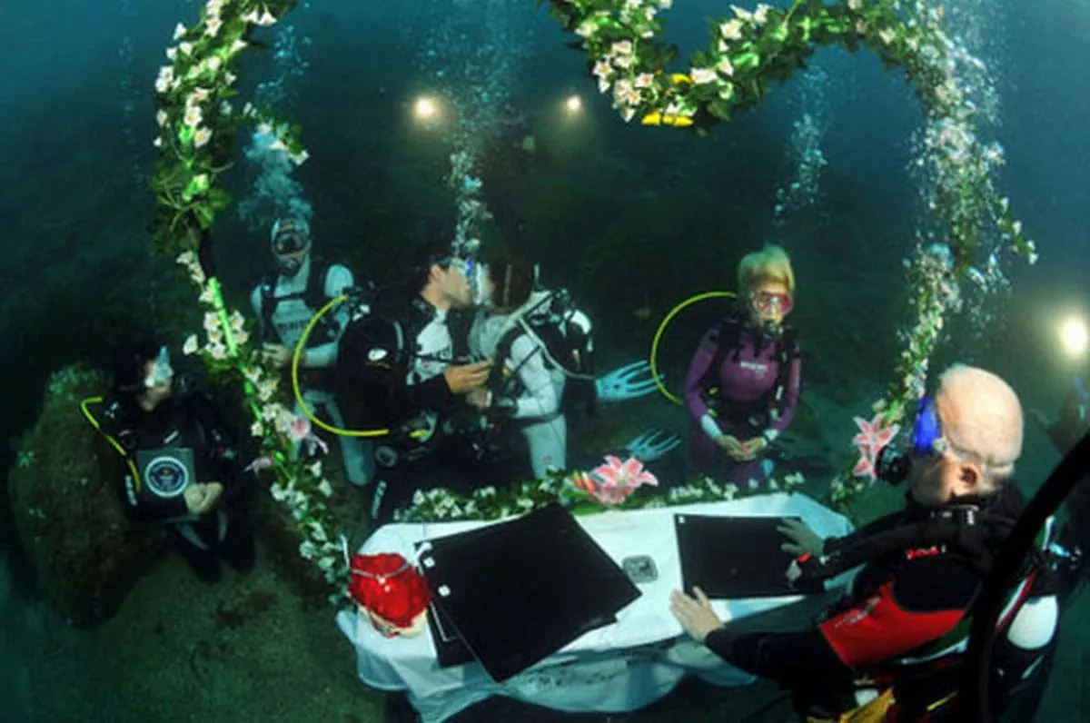
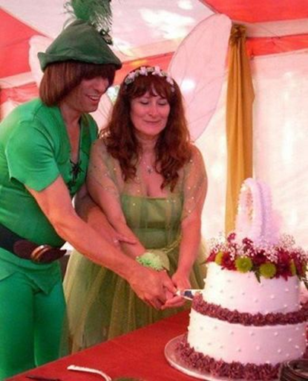
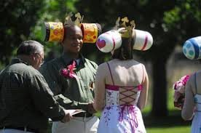

Slide 3
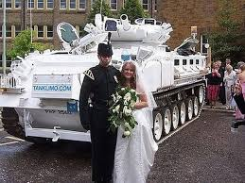
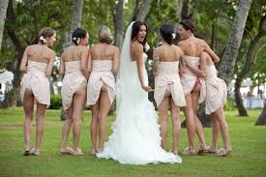
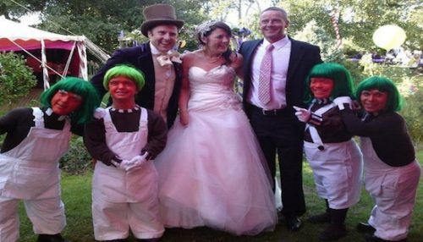
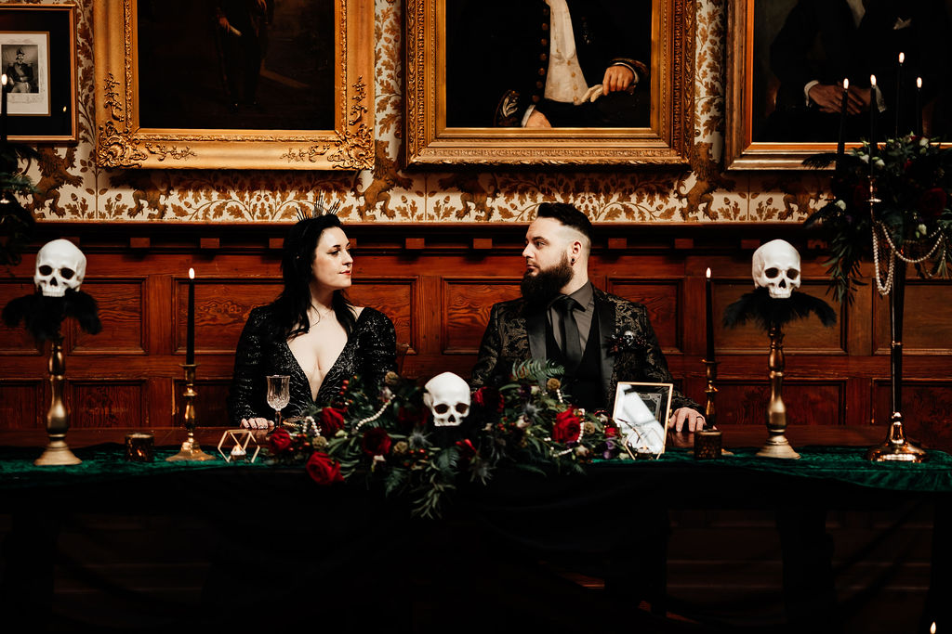
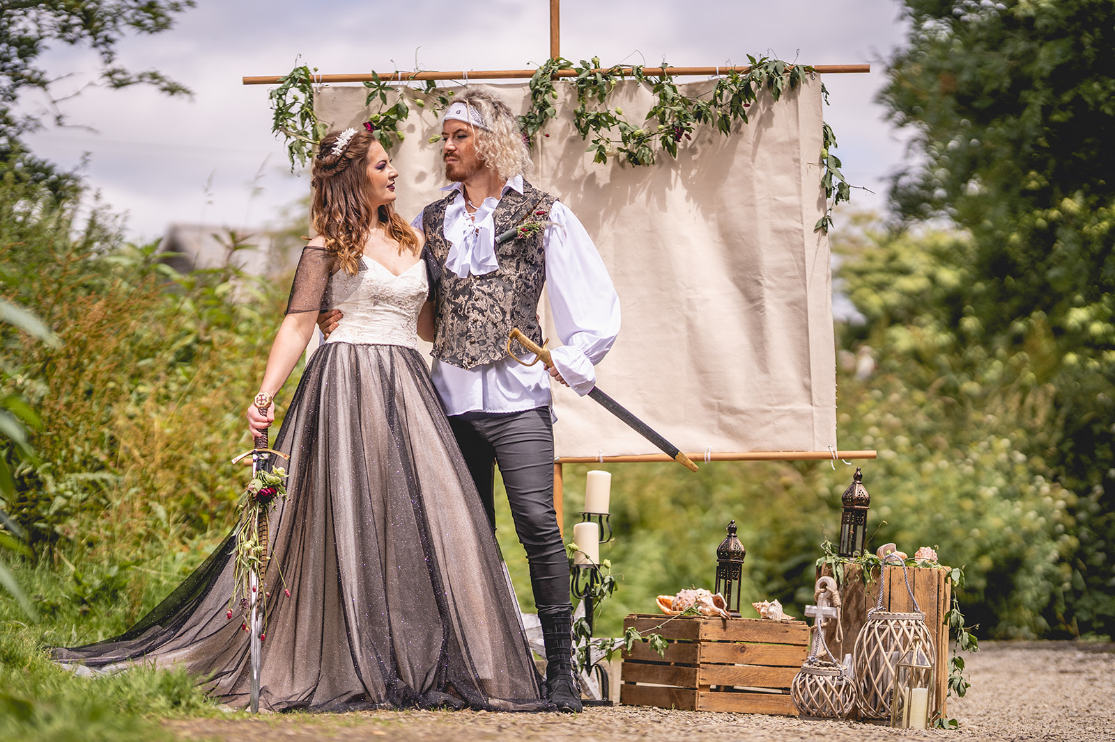
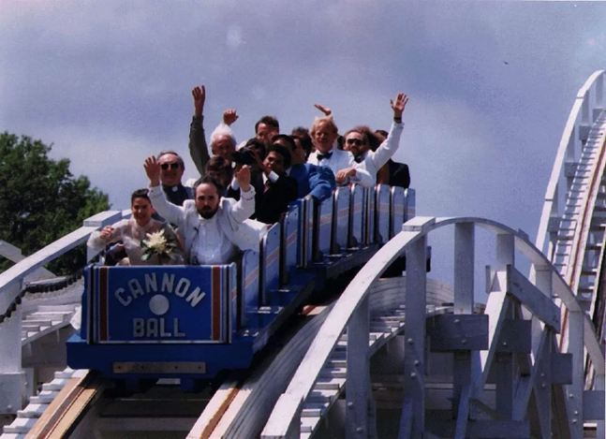

Slide 4
Read the Parable. Matthew 22:1-14
Activity 1
1. Who are the characters meant to be?
Father, Son, initial guests, second guests, servants/messengers
2. What is the obvious message of this parable? Discuss with a partner and then feedback to the group

Slide 5
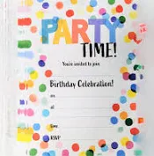
Activity 2
Excuses or acceptance?
What is it like to be invited to someone else’s celebration or party? What does it mean?
2. Why do we sometimes make excuses not to attend? What excuses do we
make?
3. You have been invited by God to be part of His Kingdom, this means He
cares for you and loves you. How does that make you feel? How should
you respond?

Slide 6
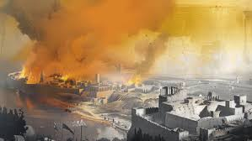
Read v 5-7
Activity 3
1. How would you react if none of your friends responded to your special party invitation?
2. Was God’s reaction just? Why?
3. God does not abandon His party plans, what does He do?

Slide 7
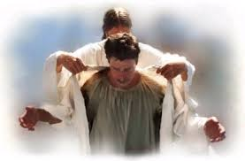
The Right Clothes
Activity 4
1. Why was the man thrown out of the feast in v11-13
(see note in resources section)
2. What do you think wearing the right clothes is really all
about?
3. What would happen if you turned up to a wedding in your
DIY, paint covered clothes or your dirty sports kit? Why
is wrong to do so?

Slide 8
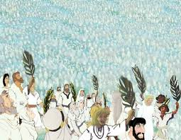
A picture of our future
Takeaway
After this I looked, and behold, a great multitude that no one could number, from every nation, from all tribes and peoples and languages, standing before the throne and before the Lamb, clothed in white robes, with palm branches in their hands, Revelation 7:9

