Slide 1
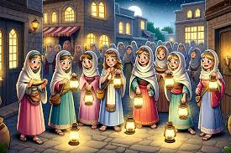
The Parable of the ten bridesmaids Matt 25:1-13
.

Slide 2
Holiday on a deserted Island
You are going to stay on a deserted Caribbean island for a long time. You can ONLY take 7 things… Think carefully about the essentials
Sun cream Solar powered Kindle with 100 books
Penknife pot of Vaseline cotton wool balls fishing knife
Hairdryer make up small medical kit mobile phone
Flip flops one complete set of spare clothes solar charger and cable floppy hat nylon wire (100m) empty note book Pen tent sleeping bag teddy bear torch
Compass Bible cagoule toilet paper soap black bin bags bucket spade bug spray

Slide 3
Read Matthew 25:1-13
Activity 1
Discuss the questions in pairs or 3s and feedback ideas
1. What is this parable about?
2. Why do you think the foolish bridesmaids didn’t bring enough oil with them?
3. Do you think the wise bridesmaids should have shared?

Slide 4
Activity 2
How can we ensure that we stay spiritually ready for Christ’s return in our own lives?
2. What are some common distractions that may hinder our
spiritual preparedness?
How can we support and encourage one another to
remain faithful and prepared?

Slide 5
Activity 3
Should I worry about the return of Jesus?
What do you know about the return of Jesus?
Read: 1 Thessalonians 5:1-11
1. How will it happen?
2. How are believers different to non believers?
3. How should believers act?
4. What can they rely on?

