Slide 1

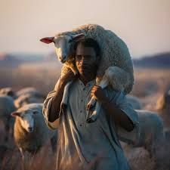
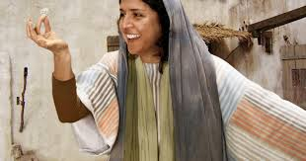
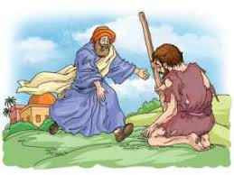
The parables of the LOST!
Luke 15

Slide 2
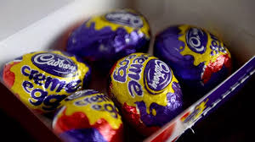
Searching for the lost!
In the garden are twenty chocolate eggs.
Find them and bring them back to me… we can then share them out!

Slide 3

Watch the clip
Activity 1
Parables of the lost
Read the chapter…Luke 15

Slide 4
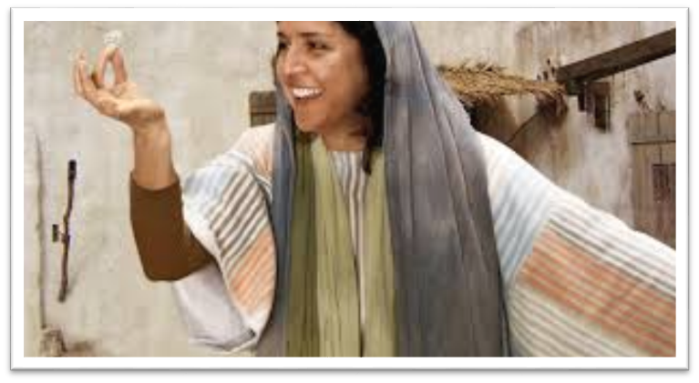
Activity 1
The Lost coin
1. Why did the woman search for the coin? She still had lots more?
2. How well did she look?
3. What does this teach us about what God thinks of you?

Slide 5
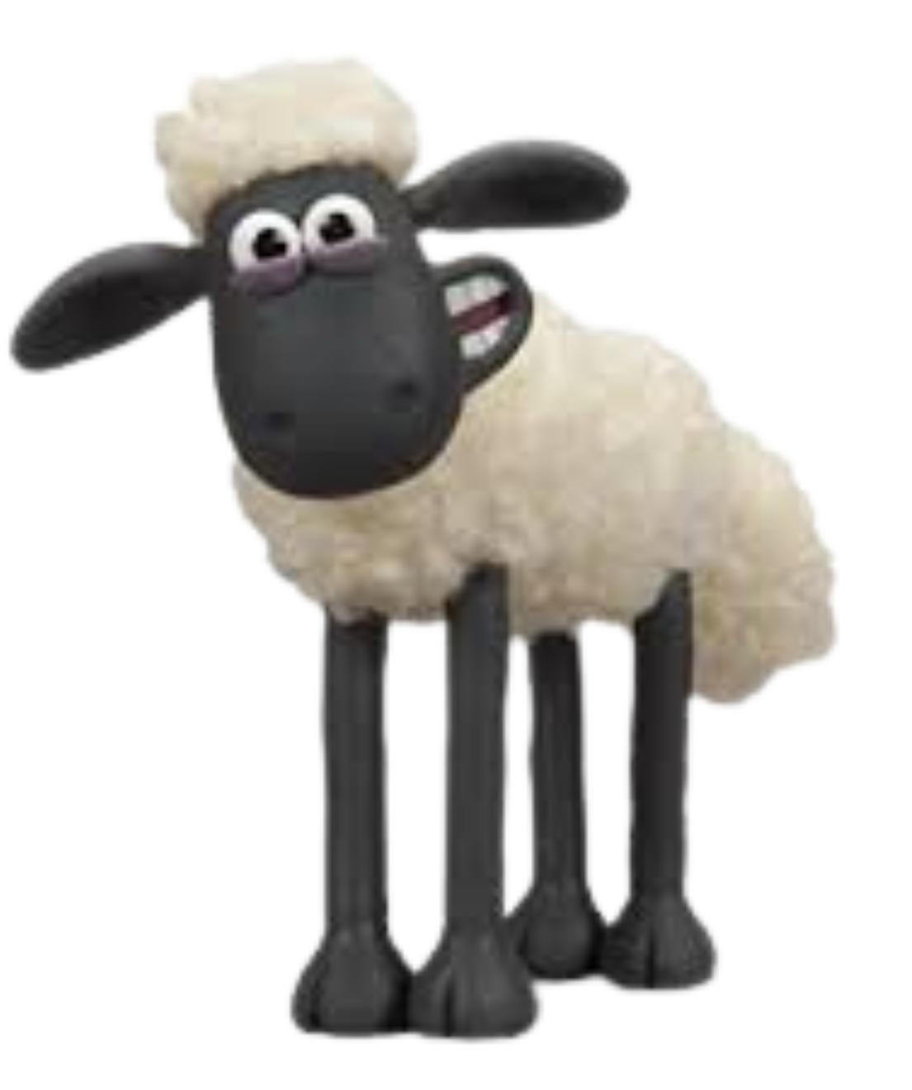
Activity 2
The lost Sheep
Poor Shaun is lost in the Garden Room.
Can you find him for me?

Slide 6
Activity 2
The lost Sheep
In the parable, why do you think the sheep got lost?
2. In what way are people like sheep?
3. What stops us hearing the shepherd’s (Jesus)
voice and instructions?
4. How do you think Jesus (the Good Shepherd)
is calling and searching for you?

Slide 7
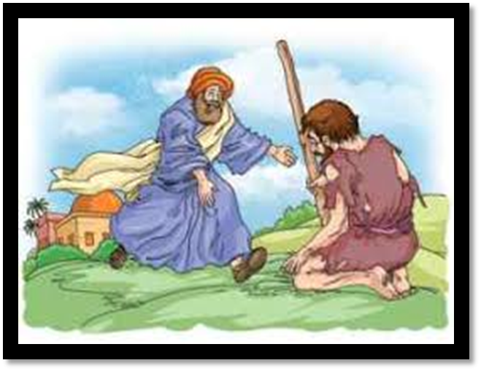
The Lost Son
Activity 3
1. What is the big difference between the coin, sheep and this
parable, the Lost Son?
2. Why did the lost son return home?
3. What does the father’s reaction to his son coming home
teach us about God’s reaction to us?
4. What did the son do to become reunited with his family?
5. Why do you think the other son reacted as he did?

Slide 8
Give out a chocolate egg to everyone … the ones we hunted for at the start!
Takeaway
But we had to celebrate and be glad, because this brother of yours was dead and is alive again; he was lost and is found.
Luke 15:32

