Slide 1
The Childhood of Jesus
The Life of Jesus Series

Slide 2
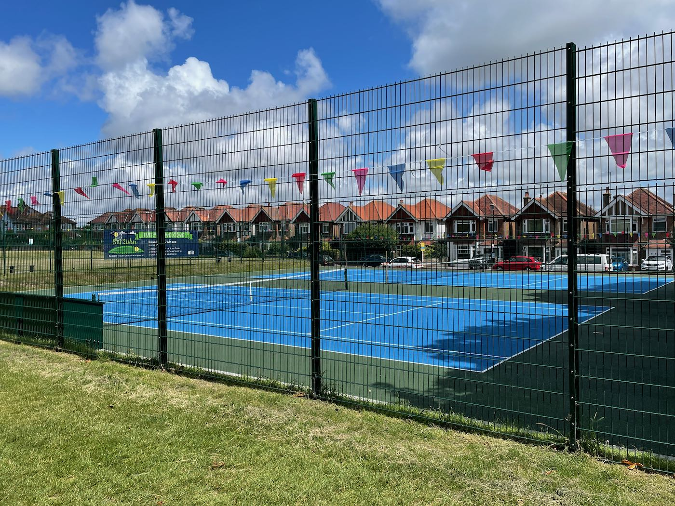
Where….?
Old Town Recreation Ground

Slide 3
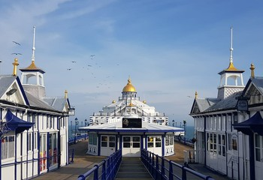
Where….?
Eastbourne Pier

Slide 4
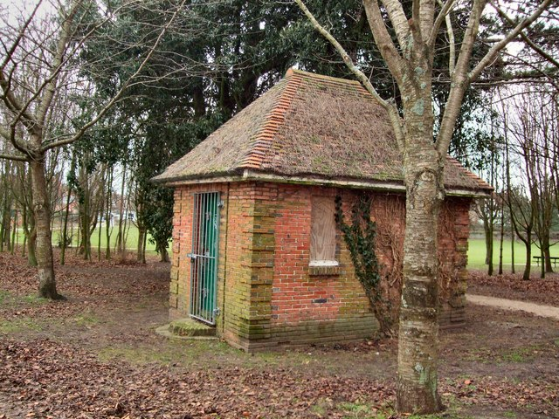
Where….?
Gildredge Park

Slide 5
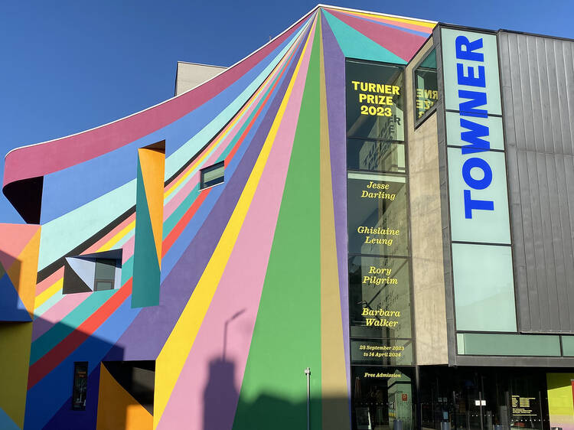
Where….?
The Towner

Slide 6
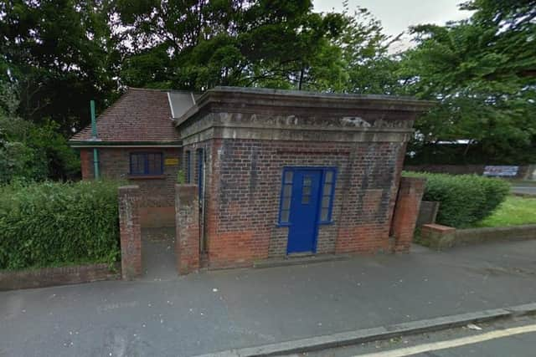
Where….?
The Old Toilets, Albert Parade

Slide 7
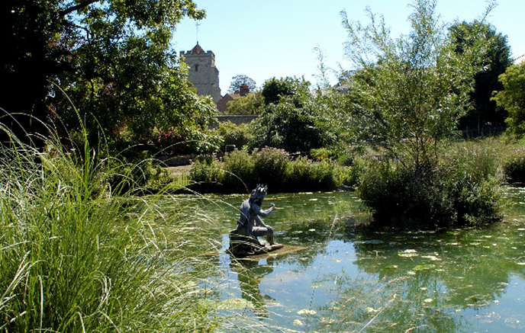
Where….?
Motcombe Gardens

Slide 8
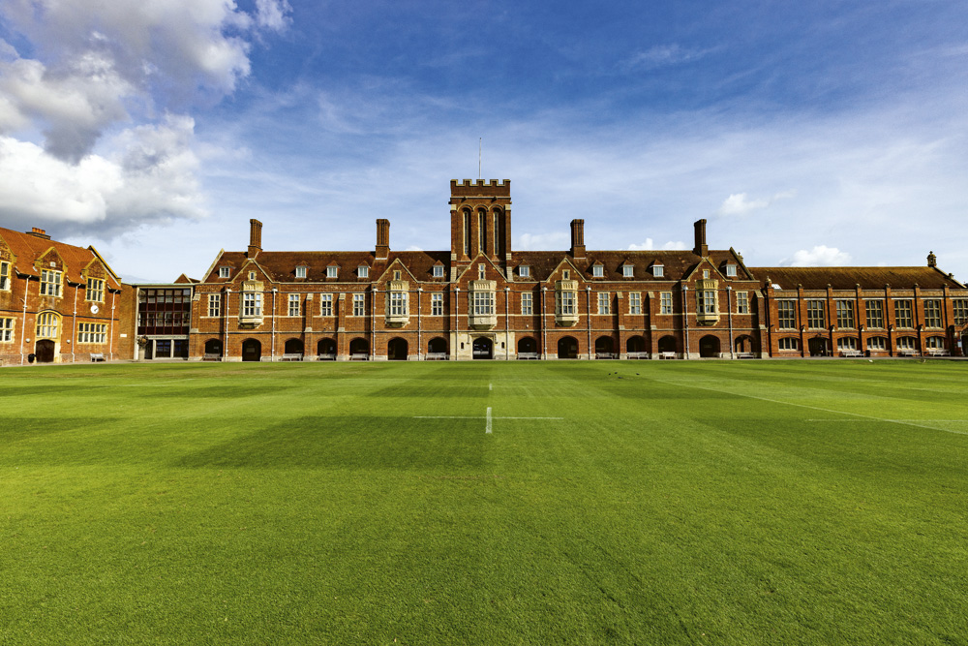
Where….?
Eastbourne College

Slide 9
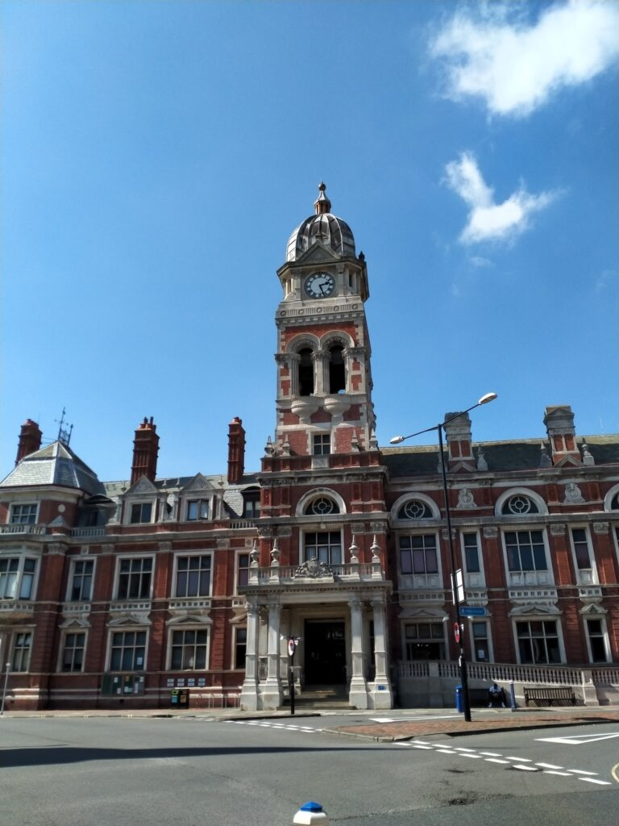
Where….?
Eastbourne Town Hall

Slide 10
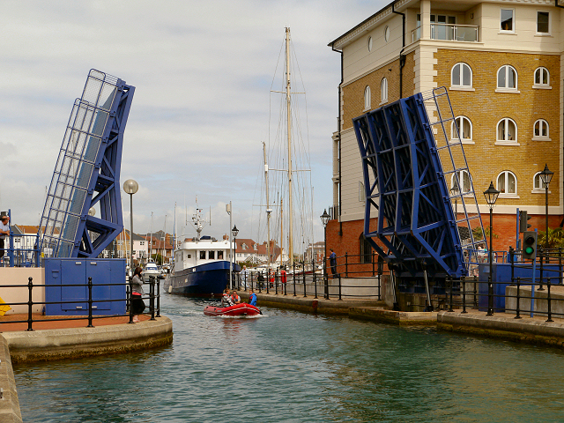
Where….?
Sovereign Harbour Bridge

Slide 11
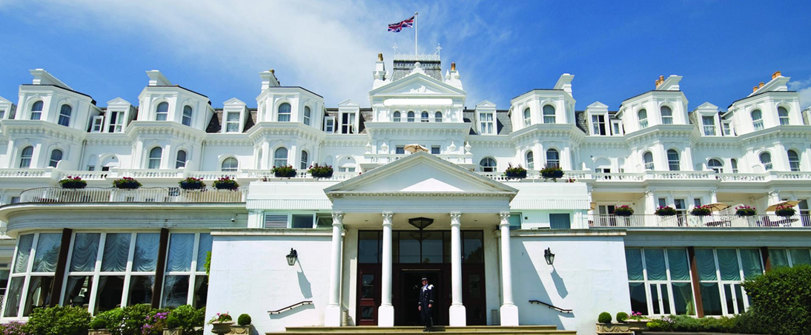
Where….?
The Grand Hotel

Slide 12
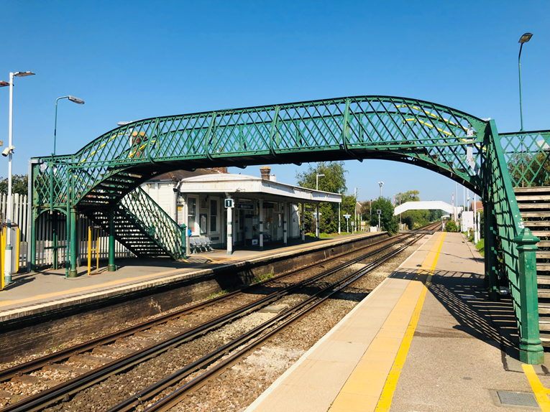
Where….?
Hampden Park Station

Slide 13
Matthew 2:13-15
What was your earliest memory?
What impact would being a refugee have on Jesus?

Slide 14
Luke 2:41-52
Have you ever been lost before?
Looking at each verse, can you see different things about Jesus’ character?
What was Jesus’ priority?

Slide 15
Psalm 84: 1-4 & 10
What are your thoughts on this Psalm?
Can you imagine being a position to say this?

Slide 16
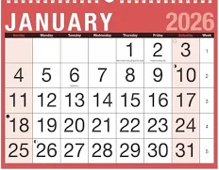
Make a Calendar

