Slide 1

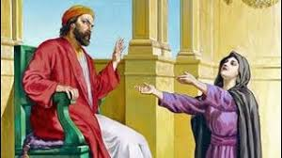
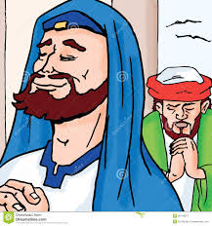
The Parables of:
The Persistent Widow.
The Pharisee and the tax collector.
Luke 18:1-14
.

Slide 2
Are we there yet?
What qualities do the children and the man show?

Slide 3
I’ll never get tired of…
Activity 1
1. What do you think you would never get tired of?
(e.g: eating pizza, playing Xbox, watching TV)
2. Why? What makes it so important in your life?
3. Is there anything you thought you would never
stop doing, but now have?

Slide 4

Read Luke 18:1-8
Activity 2
1. What do you think the parable means?
2. Why was the woman so determined?
3. Why did the judge eventually give in?
4. Is God like the judge, or is He different? If so, how?
5. Make up a summary sentence for the parable.
Write it on a sheet of paper, stick them up around the room. Look at each others, are they similar?

Slide 5
Activity 3
Read Luke 18:9-14
https://youtu.be/HT2O-9uzYAk
Complete these sentences and then discuss what they mean.
When we pray we must be…
When we pray we must not…
We must confess our… and not rely on our own….

Slide 6
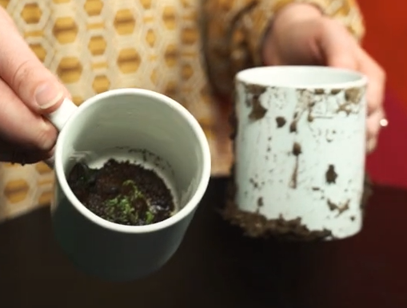
Clean mug… Dirty mug
Activity 4
How do we make people think we are nice and good?
What are the things that make us dirty on the inside?
What is Jesus more concerned about?

Slide 7
Create in me a pure heart, O God, and renew a steadfast spirit within me.
Psalm 51:10
Takeaway

