Slide 1

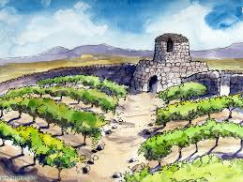
The Parable of the Tenants in the Vineyard
Luke 20:9-19
.

Slide 2
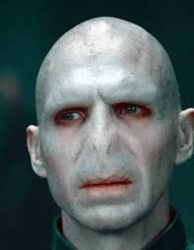
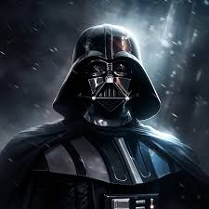
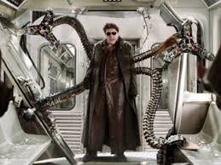
Who is this storybook villain?

Slide 3
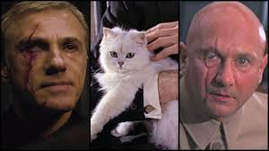
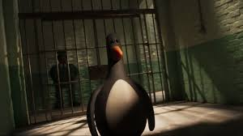

Slide 4
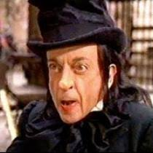
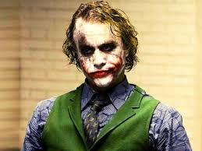
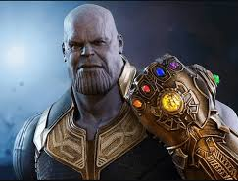

Slide 5

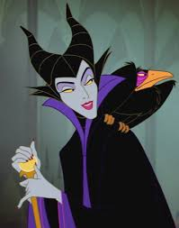
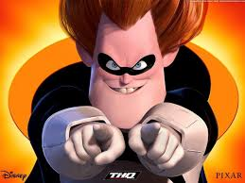

Slide 6

What makes a villain bad?
Who is the worst storybook villain?

Slide 7

Read Luke 20:9-19
Activity 1
Using the cards match up the characters to who they represent
Highlight the similarities between Isaiah 5 and the parable.

Slide 8
Discussion: What do you think Jesus was trying to tell the people?
Activity 2
“The stone the builders rejected has become the capstone”
What does this mean?

Slide 9
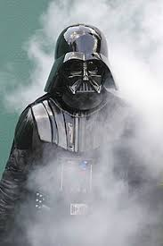
Resistance is futile
Activity 3
Mr Bond... I expect you to die!
In what way is Jesus opposite to the unstoppable
force of evil of storybook villains?
How does the parable give us confidence that justice
will win?

Slide 10

Read v 15
Activity 4
Why do the people react with “may this never be”? What are they referring to? The son being killed or the expulsion of the tenants?
What is your reaction to the end of the parable? Are you like the Pharisees and leaders who were angry because they were caught out? Or do you sympathise with the vineyard owner? Would you like to be a new tenant?

Slide 11
Will you be a good tenant or a bad one? We all have a choice to make about Jesus? What is your choice?
Takeaway

