Slide 1
The Parables of the hidden treasure and the pearl of great price: Matthew 13:43-46
.

Slide 2
Let’s play
You each have some “money”. You can keep it,
or you can bid for something worth more.
How much will you bid?

Slide 3
Watch this!
Activity 1
https://www.youtube.com/watch?v=hau_EBZWks8
Read Matthew 13:43-46

Slide 4
Activity 1
Apart from your life, what is the most valuable thing you have/ own?
2. Would you trade it for : A. A better mobile?
B. Good exam results? C. £10,000? D. A forever friend? E. Something else
3. Read Matthew 19:16-22. What was the man’s problem? Are we like this?

Slide 5
Activity 2
Look up the following verses… what do you think they mean? What do they teach about following Jesus?
Matthew 8:18-22 Matthew 16:24-26
Luke 14:28-33 Matthew 18:8-9

Slide 6
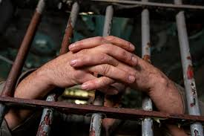
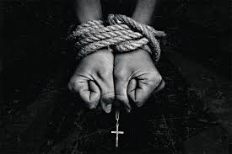
The cost of discipleship
Activity 3
Read the stories in pairs or small groups.
1. What does it cost them to follow Jesus?
2. What makes it difficult to be a Christian in the UK? What does it cost us?
3. What differences are there between the UK and places like Iran/ Sudan/
China etc. How does that make you feel about your faith?

Slide 7
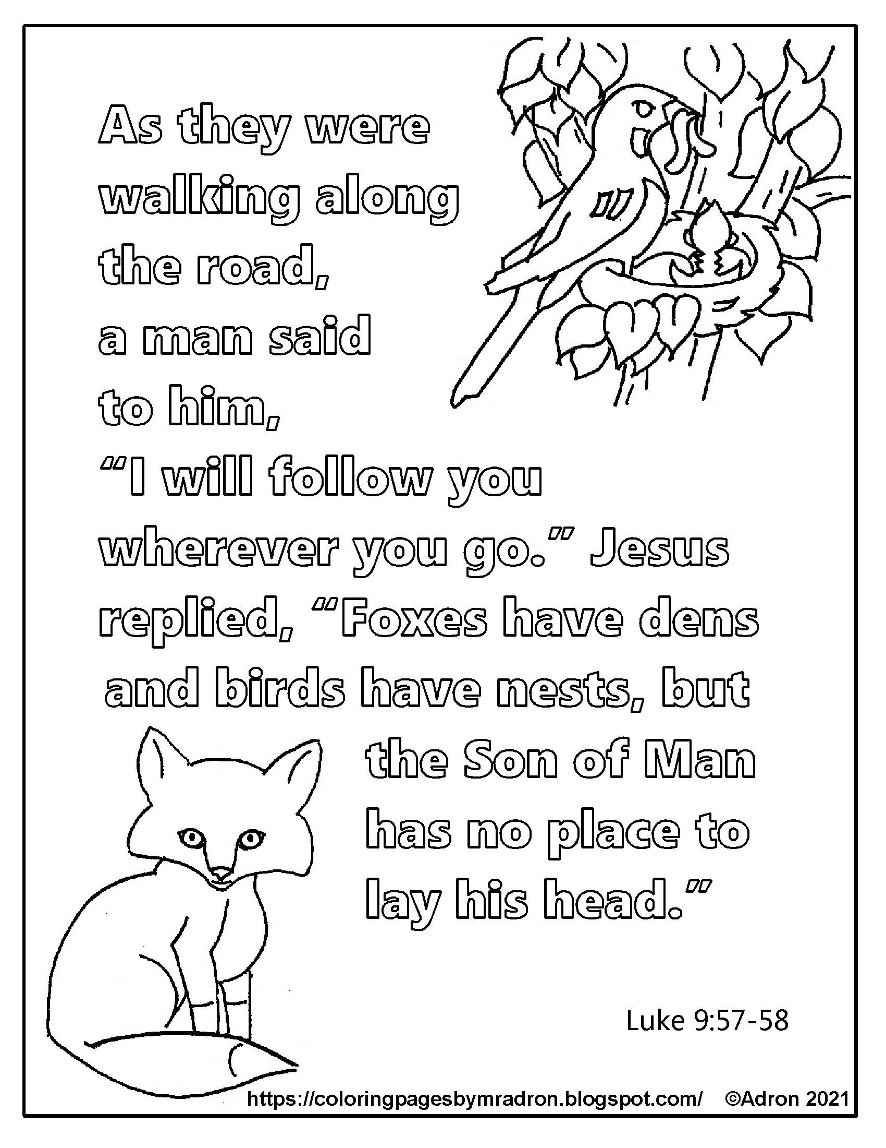
Quiet reflection time
Activity 4
What have you learned?
What has been the impact on your faith?
How far will they commit to Jesus?
What will it cost you?

