Slide 1


Slide 2
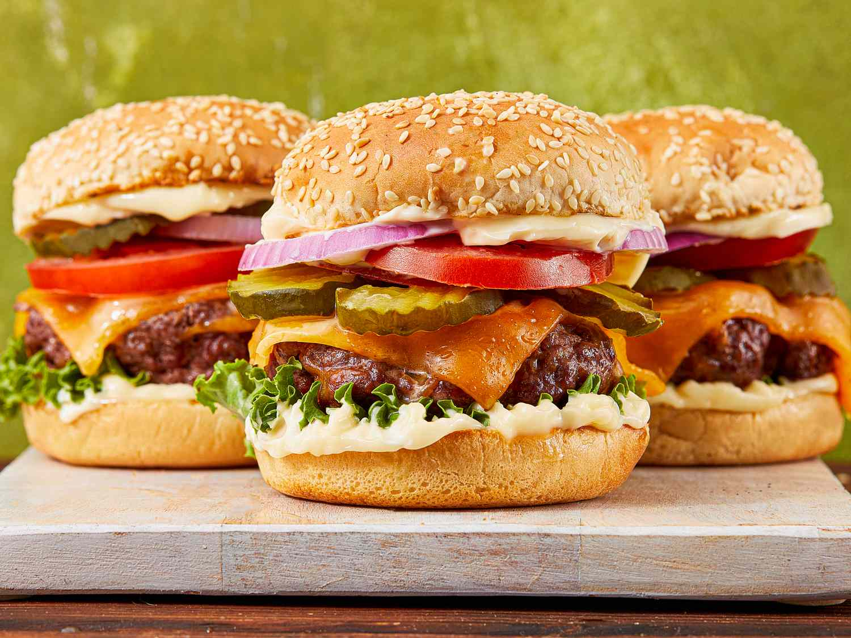
Is it cake?
NOT CAKE

Slide 3
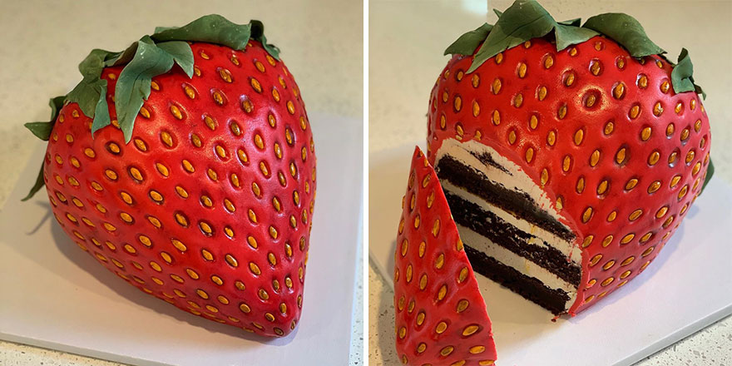
Is it cake?

Slide 4
Is it cake?

Slide 5
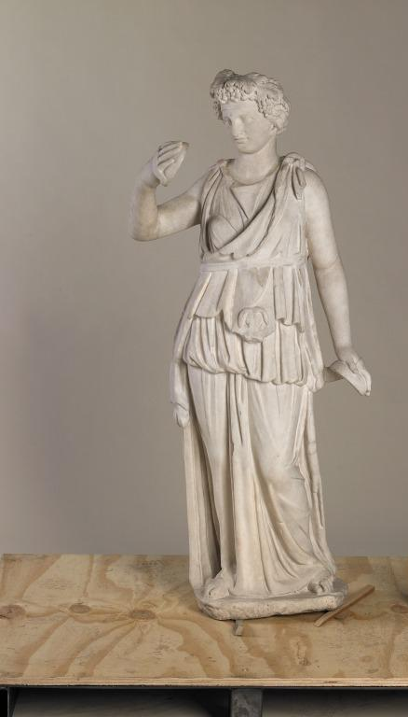
Is it cake?
NOT CAKE

Slide 6

Is it cake?
NOT CAKE

Slide 7
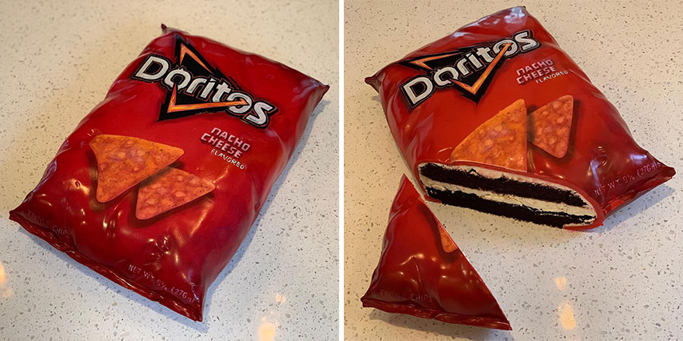
Is it cake?

Slide 8
CAKE

Slide 9
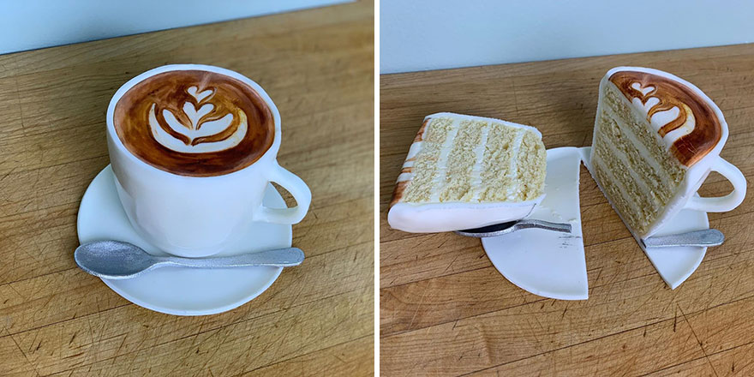
Is it cake?

Slide 10
cake

Slide 11
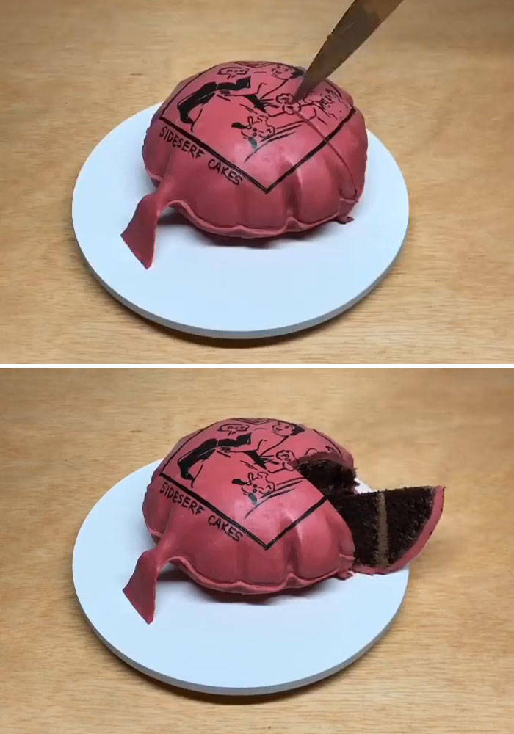
Is it cake?

Slide 12
Cake

Slide 13
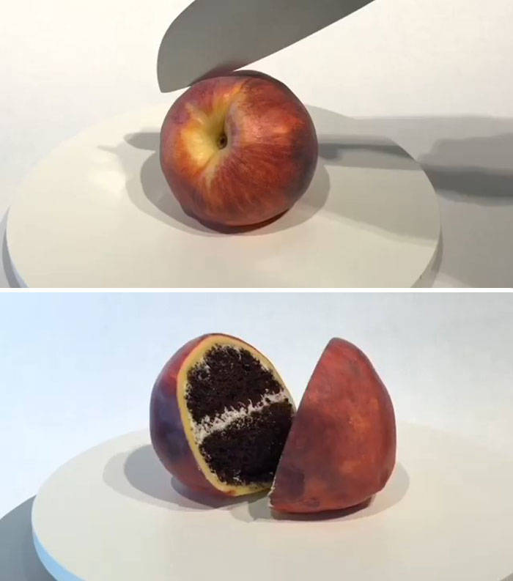
Is it cake?

Slide 14
Cake

Slide 15
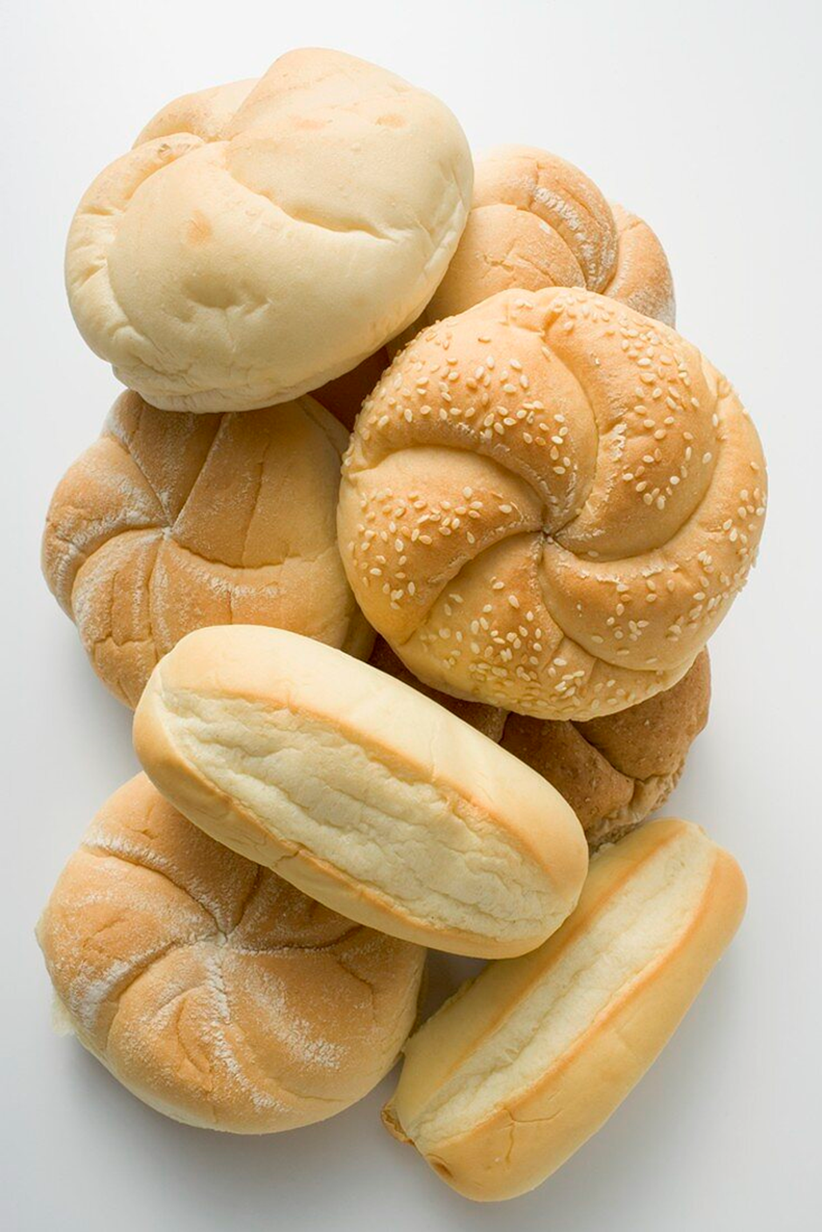

Is it cake?

Slide 16
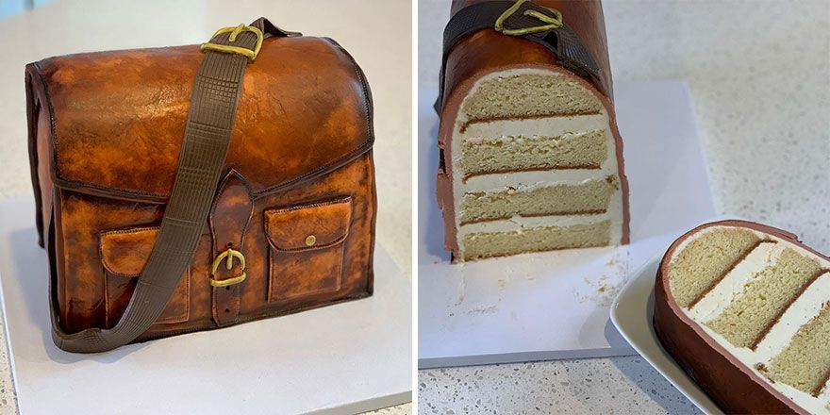
Is it cake?

Slide 17
Cake

Slide 18
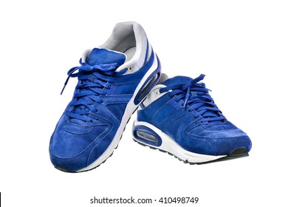
Is it cake?
NOT CAKE

Slide 19
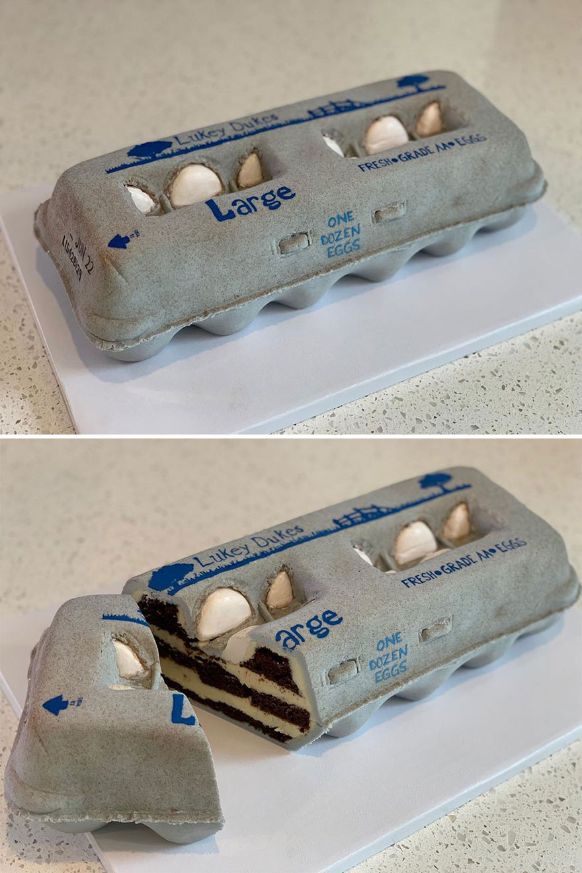
Is it cake?

Slide 20
Cake

Slide 21

Is it cake?
NOT CAKE

Slide 22
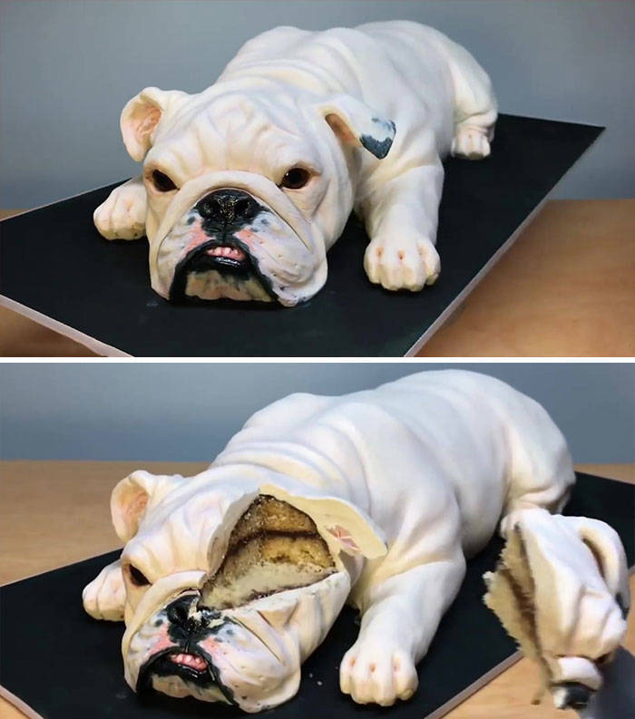
Is it cake?

Slide 23
CAKE

Slide 24
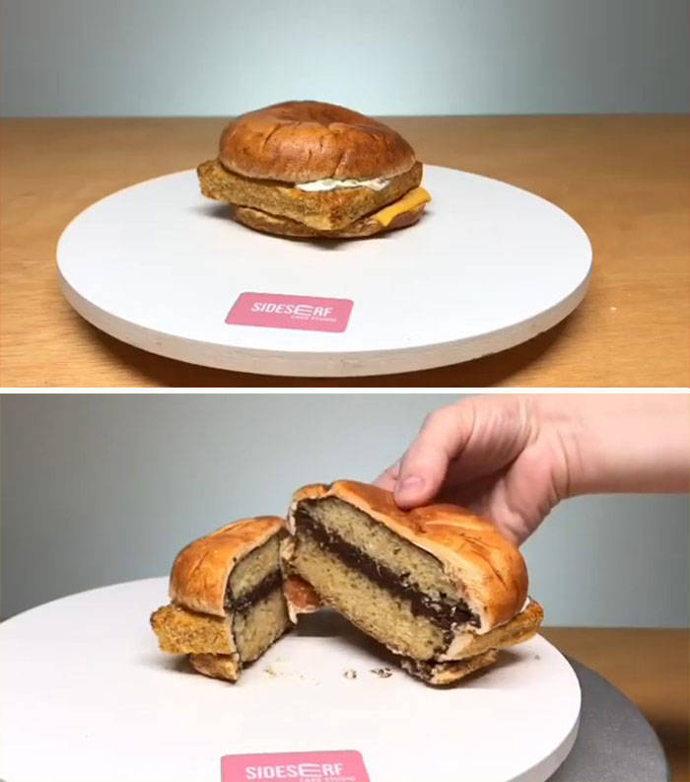
Is it cake?

Slide 25
Cake

Slide 26

Is it cake?
NOT CAKE

Slide 27
HE’S FOR REAL – QUIZ
Where was Jesus born?
ANSWER: Bethlehem
2. What was his mum called?
ANSWER: Mary
3. What gifts did the Wise men bring Jesus?
ANSWER: Gold, Frankincense and Myrrh

Slide 28
HE’S FOR REAL – QUIZ
4. What was the name of his cousin?
ANSWER: John the Baptist
5. Who ruled Jesus' country at the time of his birth?
ANSWER: The Romans
6. In which town did Jesus grow up?
ANSWER: Nazareth

Slide 29
HE’S FOR REAL – QUIZ
7. What job did Jesus have?
ANSWER: Carpenter
8. How old was Jesus when he began to go around preaching?
ANSWER: 30 years old
9. Can you name four of Jesus' disciples?
ANSWER: Peter, Andrew, James, John, Matthew, Philip, Bartholomew, Thomas, Matthew James, Judas, Simon the Zealot and Judas Iscariot

Slide 30
HE’S FOR REAL – QUIZ
10. What does the name Jesus mean a) gift b) the Lord saves or c) peace?
ANSWER: B – the Lord saves
11. Who did Jesus say he was?
ANSWER: God, the Son of Man, the Son of God, Messiah
12. At what event did a dove appear above Jesus?
ANSWER: His baptism

Slide 31
HE’S FOR REAL – QUIZ
13. What was the first miracle Jesus performed?
ANSWER: Turning the water in wine
14. What's the Sunday before Easter called?
ANSWER: Palm Sunday
15. What did Jesus do on Palm Sunday?
ANSWER: Rode into Jerusalem on a donkey

Slide 32
HE’S FOR REAL – QUIZ
16. Which disciple betrayed Jesus?
ANSWER: Judas Iscariot
17. Name the Roman official who handed Jesus over to the Jews?
ANSWER: Pilate
18. How was Jesus put to death?
ANSWER: Crucified

Slide 33
HE’S FOR REAL – QUIZ
19. On what day do we remember how Jesus died?
ANSWER: Good Friday
20. . How many days was Jesus dead?
ANSWER: Three

Slide 34

Evidence that Jesus Was a Real Man
• Tacitus (Roman historian): writes that Christus executed under Pontius Pilate
• Josephus (Jewish historian): Mentions 'Jesus, called Christ' & brother James
• Pliny the Younger: Early Christians worshiped Christ as divine
• Talmud: Mentions Jesus’ execution
• Early Christian writings: Paul & Gospels (Historians acknowledge these contain authentic details about Jesus. → The overwhelming consensus: Jesus lived, was Jewish teacher in Judea, baptized by John the Baptist and was crucified under Pilate

Slide 35


Luke 5:18-25 Luke 7:11-16
Matthew 8:23-27 Matthew 12:22
What kind of miracle is this?
How did Jesus show His power?
Write a newspaper headline for this miracle.

Slide 36
Isaiah 42:1
Matthew 20:28
Matthew 3:17
John 3:16
Mark 1:11
John 1:32
Luke 4:18
He's a servant
He's supported by God
Chosen by God
God is pleased with Him
He’s filled with God’s Spirit.
He'll bring justice to the nations

Slide 37



Philipians 2:5-11
What do these verses tell us about Jesus?
How might we feel challenged by this passage?

Slide 38
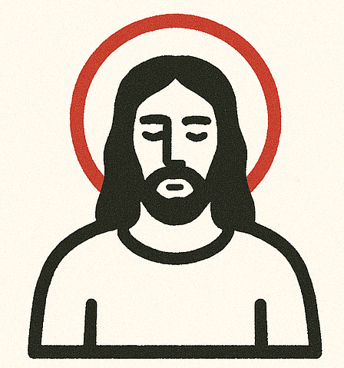
Challenge:
Spend 10 minutes a day with Jesus.

