Slide 1

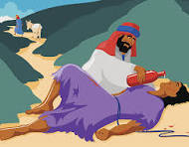
The Good Samaritan
Luke 10:25-37
.

Slide 2

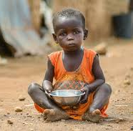


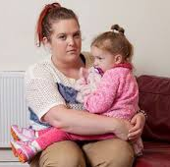
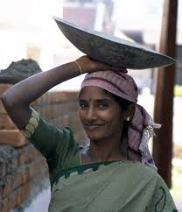
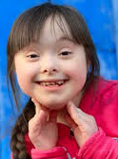


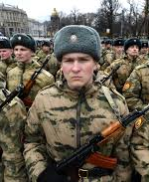
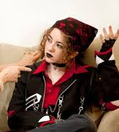
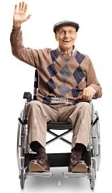


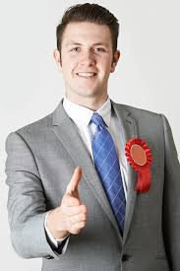
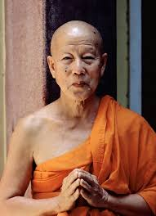
Balloon debate
You are in a balloon with several others. It is losing height and someone needs to be sacrificed in order for the others to survive. You cannot choose yourself to die

Slide 3
Read Luke 10:25-37 cheesy video
Activity 1
This is a familiar parable to most of you. What have you
been taught about it?
2. If Jesus were telling this today, who would be the
characters?
3. The priest and the Levite often get bad press. Were
they really so bad?
4. What would make you cross over the road?

Slide 4
Samaritan in action
Activity 2
What do you think of his actions?
What might you do?

Slide 5
A danger in the story
It is easy to turn this story into just a moral about helping others and not being racist etc. If we do that we ignore the context and a deeper meaning as well.
1. What was the context? What was going on before the
story began?
2. Why did Jesus tell the story?
3. What is the command at the end of the story?
Activity 3

Slide 6
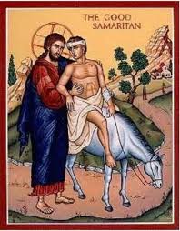
Jesus is our Good Samaritan
1. In what way is Jesus like the Samaritan?
2. How are we like the injured person?
3. What do the priest and Levite represent?
Activity 4

Slide 7
Write your name on a hand
Stick it together to create a hand circle!

