Slide 1
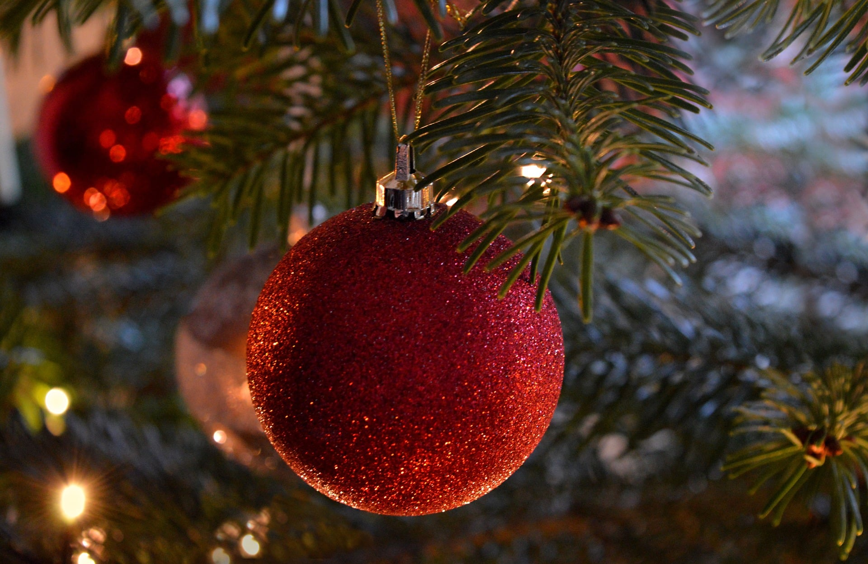
Christmas

Slide 2
Christmas Quiz

Slide 3
1. What ornaments do elves traditionally have on their shoes?
2. What are the colour of mistletoe berries?
3. What are the names of Santa’s reindeer?
4. In which country is KFC commonly consumed for Christmas dinner?
5.What country started the tradition of gifting chocolate coins?
6. What colour was Santa’s suit before he was rebranded red by Coca Cola?
7. Who wrote the iconic story, A Christmas Carol?
8.What name is given to small sausages wrapped in bacon, a staple at a British Christmas dinner?
9. In the Harry Potter series, in the wizarding world, what do they call Christmas crackers?

Slide 4
10. In Home Alone, where is the McCallister family going on vacation when they leave Kevin behind?
11. Which reindeer has a name that means “thunder”?
12. In the song The Twelve Days of Christmas, what gift is given on the seventh day?
13. In How the Grinch Stole Christmas, what is the Grinch’s dog’s name?
14. What do you traditionally hide inside a Christmas pudding?
15. What holiday drink do people often spice with cinnamon, cloves, and orange?

Slide 5
1. What ornaments do elves traditionally have on their shoes?
1. Bells
2. What are the colour of mistletoe berries?
2. White
3. What are the names of Santa’s reindeer?
3. Blitzen, Comet, Cupid, Dasher, Prancer, Vixen, Dancer and Donner
4. In which country is KFC commonly consumed for Christmas dinner?
4. Japan
5.What country started the tradition of gifting chocolate coins?
5. America
6. What colour was Santa’s suit before he was rebranded red by Coca Cola?
6. Green
7. Who wrote the iconic story, A Christmas Carol?
7.Charles Dickens
8.What name is given to small sausages wrapped in bacon, a staple at a British Christmas dinner?
8. Pigs in blankets.
9. In the Harry Potter series, in the wizarding world, what do they call Christmas crackers?
9. Wizarding Crackers

Slide 6
10. In Home Alone, where is the McCallister family going on vacation when they leave Kevin behind?
10. Paris
11. Which reindeer has a name that means “thunder”?
11. Donnor
12. In the song The Twelve Days of Christmas, what gift is given on the seventh day?
12. Seven swans a-swimming
13. In How the Grinch Stole Christmas, what is the Grinch’s dog’s name?
13. Max
14. What do you traditionally hide inside a Christmas pudding?
14. A Coin
15. What holiday drink do people often spice with cinnamon, cloves, and orange?
15. Mulled Wine

