Slide 1

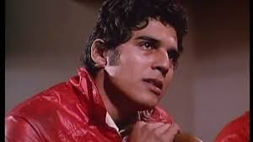




What the Bible says about how to be
Be Prepared
Be…

Slide 2
What the Bible says about how to be
Let’s tell a story
Be…

Slide 3
What the Bible says about how to be
Activity 1
Read together Matthew 28:18-20, and
1 Peter3:15
1. What does Jesus command us to do?
2. What does Peter say we should do?
3. How are the two verses connected?
Be…

Slide 4


What the Bible says about how to be
Activity 2
We all have a story to tell.
Nicky Cruz and
David Wilkerson
Be…

Slide 5

What the Bible says about how to be
Activity 2
What can you learn about the story from the clip?
Be…

Slide 6
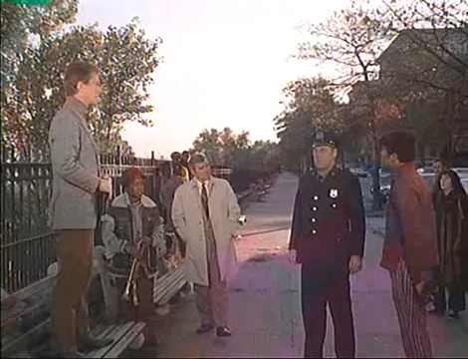
What the Bible says about how to be
Activity 2
What can we learn about the story from the clip?
Be…

Slide 7

What the Bible says about how to be
Activity 2
Apologies about the quality
This is the real Nicky talking about his life and faith
Be…

Slide 8
What the Bible says about how to be
Activity 2
What would your story be?
Not as dramatic as Nicky’s… but you still have something to share.
Talk to the person next to you about your life… something good that has happened to you… or something bad/sad.
Be…

Slide 9
What the Bible says about how to be
Activity 3
How do we talk about Jesus?
Discuss in small groups what 3-4 things you would need to say to someone to get the basics of t
Be prepared to feedback
Be…

Slide 10
What the Bible says about how to be
Activity 3
1. you are loved by the God who created all things. You ar His creation. He desires a relationship with you. Gen 1:27. John 3:16
2. Sin separates you from God, it stops you enjoying God’s love. We are all sinners. We all reject God. Romans 3:23, Romans 6:23, Isaiah 59:2
Be…

Slide 11
What the Bible says about how to be
Activity 3
3. Jesus rescues you. God sent His son Jesus to die in your place, to pay the penalty for your sin. He rose from the dead so you can enjoy a relationship with Him. 1 Peter 3:18, 1 Corinthians 15:3-8, Romans 5:8
4. Will you trust Jesus? Faith in Him will set you free from sin and bring you into relationship with God and give you eternal life. A simple prayer of confession is enough. Romans 10:9-10, Ephesians 2:8-9.

Slide 12

What the Bible says about how to be
Takeaway
Fill in your own story… and learn how to share the gospel in four simple steps…
You could save someone’s soul!
Be…

Slide 13
What the Bible says about how to be
Takeaway
Prayer time
Be…

