Slide 1
Connected to Jesus?

Slide 2
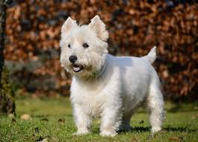
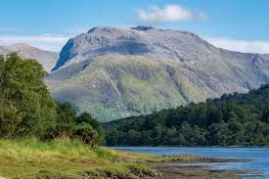
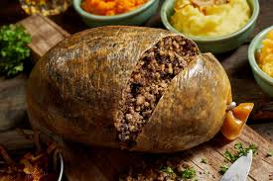
Find the connection between these clues.
If you can’t get it from the pictures… we’ll give you words too.
SCOTLAND
West Highland Terrier
Ben Nevis. Highest mountain in UK
Haggis. Traditional
Scottish food

Slide 3
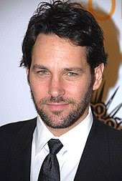
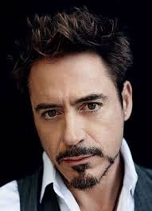
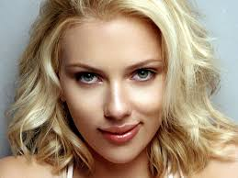
Paul Rudd
Robert Downey Jr
Marvel film actors
Scarlett Johannson

Slide 4
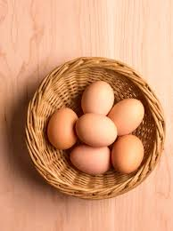
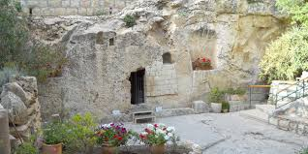
EASTER
Eggs,
May contain chocolate
Just the branches really
The Garden Tomb,
Jerusalem

Slide 5
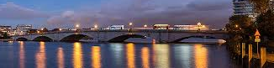
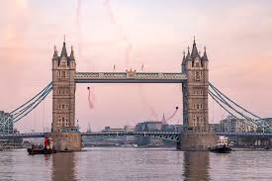
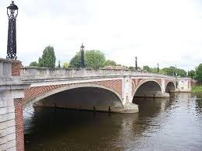
Putney Bridge
LONDON
Tower Bridge
Hampton Court Bridge

Slide 6
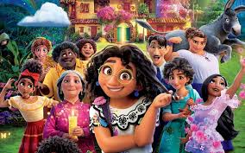
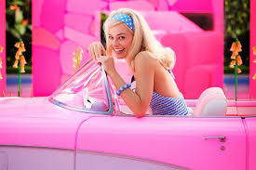
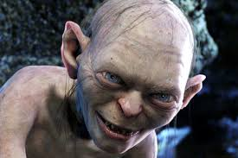
Encanto
Oscar winning films
Barbie
Lord of the Rings

Slide 7
Activity 1
Who likes silence?
What if your parents took you on holiday to a place with no WIFI?
Why do you think we like to be connected?

Slide 8
Activity 2
Has God created us to be connected?
Read out the Bible verse on your slip of paper.
How does it link to the idea of
connection /connected?

Slide 9
Activity 3
Remember our “searching session.”
What are some of the wrong things people connect with to try and find peace, contentment and happiness ?
Using playdoh, make a model of a treasured possession, money, a gadget or a person you like!

Slide 10
Activity 4
Look up these amazing verses… what do they tell us about connecting with Jesus?
John 17:3
John 14:15,17
Matthew 6:33
Colossians 3:23
Galatians 2:20
John 15:4-8
Revelation 3:19-20
Ephesians 3:17
John 16:33
1 Corinthians 16:22
John 11:25
I John 1:9
John 3:16

Slide 11
Activity 5
How do we stay connected to Jesus?
What happens when you forget to charge your mobile?
Can you keep a fire going with just one coal/log?
Look up Ephesians 6: 1--20

Slide 12
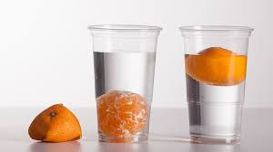
You tube clip about fruit and water

