Slide 1
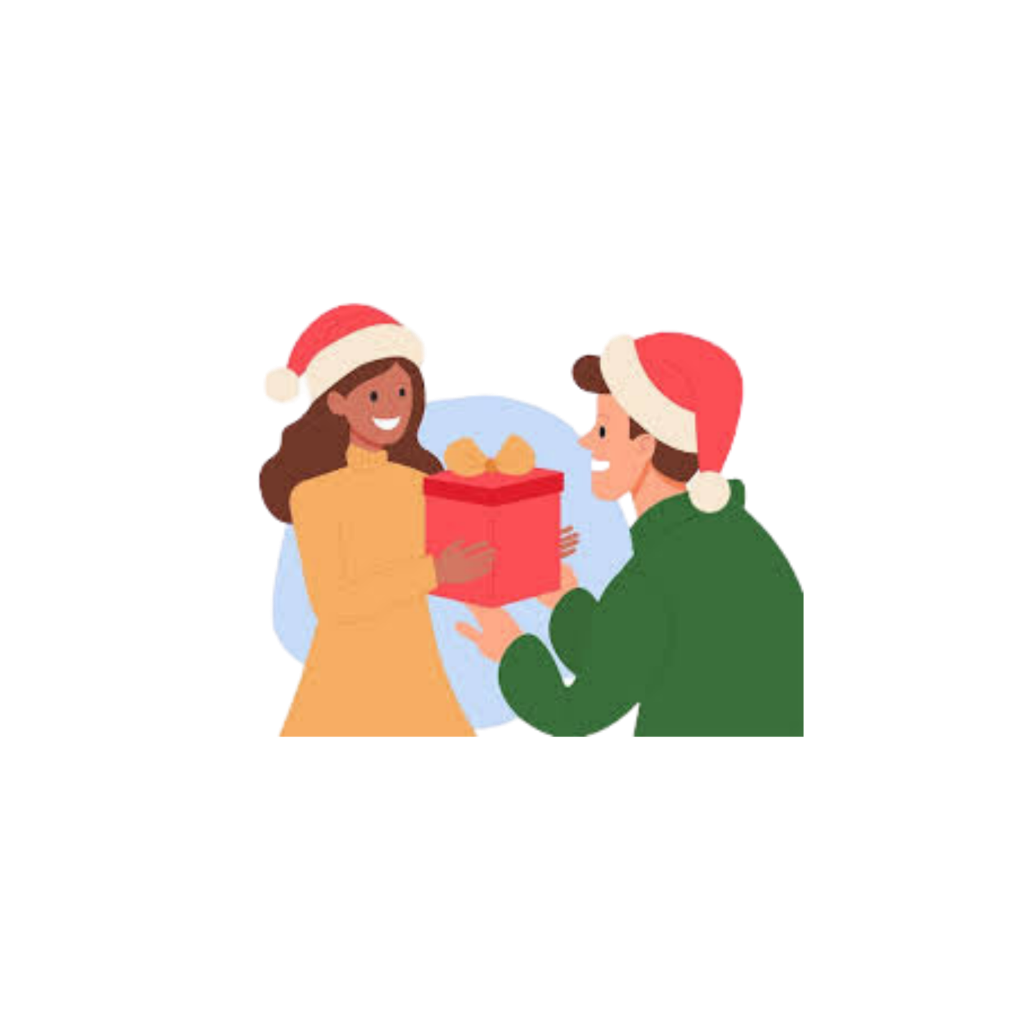
Sending and Receiving @ Christmas

Slide 2
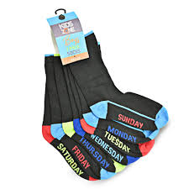
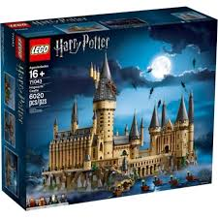
Let’s play – Good present bad present

Slide 3
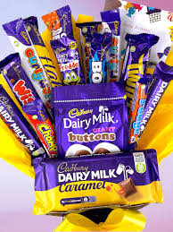
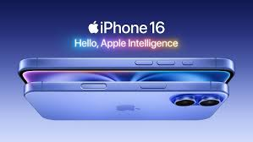

Slide 5
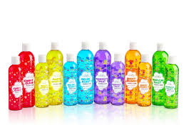

Slide 6
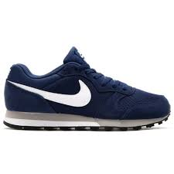
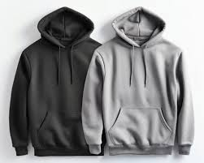

Slide 7
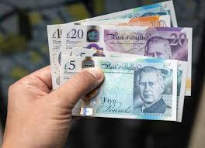
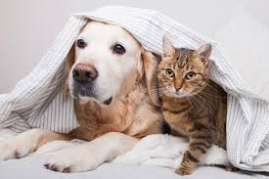

Slide 8
What makes a good present? Why?

Slide 9
Activity 1
In pairs. 30 second discussion.
Person 1: explains. “Why did God send Jesus at Christmas?”
Person 2: explains the different names people give to Jesus.

Slide 10
Activity 2
In pairs or threes, answer the question on the sheet by looking up the verses.
BE READY TO FEEDBACK

Slide 11
Activity 2
God’s gift to us is Jesus He brings us…
Salvation from sin
Eternal life
Adoption into His family
He did this because…
He loves us
It cost Him…
Everything, His Son

Slide 12
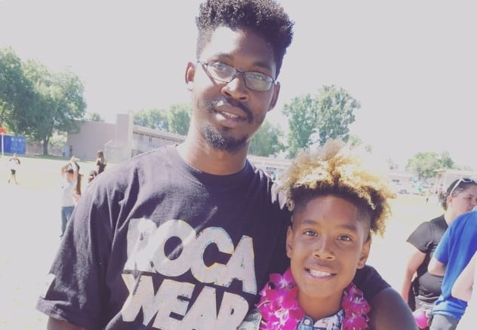
If someone saved your life by putting themselves in danger or even dying so you could live, How would you respond?
How grateful should we be that someone (a stranger) chose to protect and even rescue us?

Slide 13
Excerpts from John 14… Jesus is speaking
“If you love me, keep my commands. And I will ask the Father, and he will give you another advocate to help you and be with you forever— the Spirit of truth. The world cannot accept him, because it neither sees him nor knows him. But you know him, for he lives with you and will be in you…
Jesus replied, “Anyone who loves me will obey my teaching. My Father will love them, and we will come to them and make our home with them. Anyone who does not love me will not obey my teaching. These words you hear are not my own; they belong to the Father who sent me.

Slide 14
Matthew 22:37-39
‘Love the Lord your God with all your heart and with all your soul and with all your mind.’ This is the first and greatest commandment.
And the second is like it: ‘Love your neighbour as yourself.’ 40 All the Law and the Prophets hang on these two commandments.

Slide 15
What is my personal response to the gift of salvation and eternal life that Jesus offers?
Will I accept it or reject it?

