Slide 1
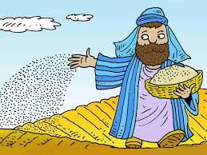
Parable of the Sower
Matthew 13:-1-8.

Slide 2
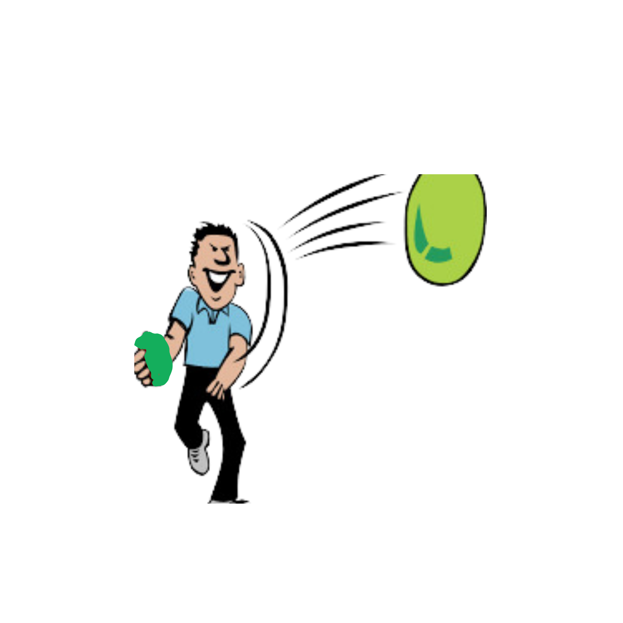
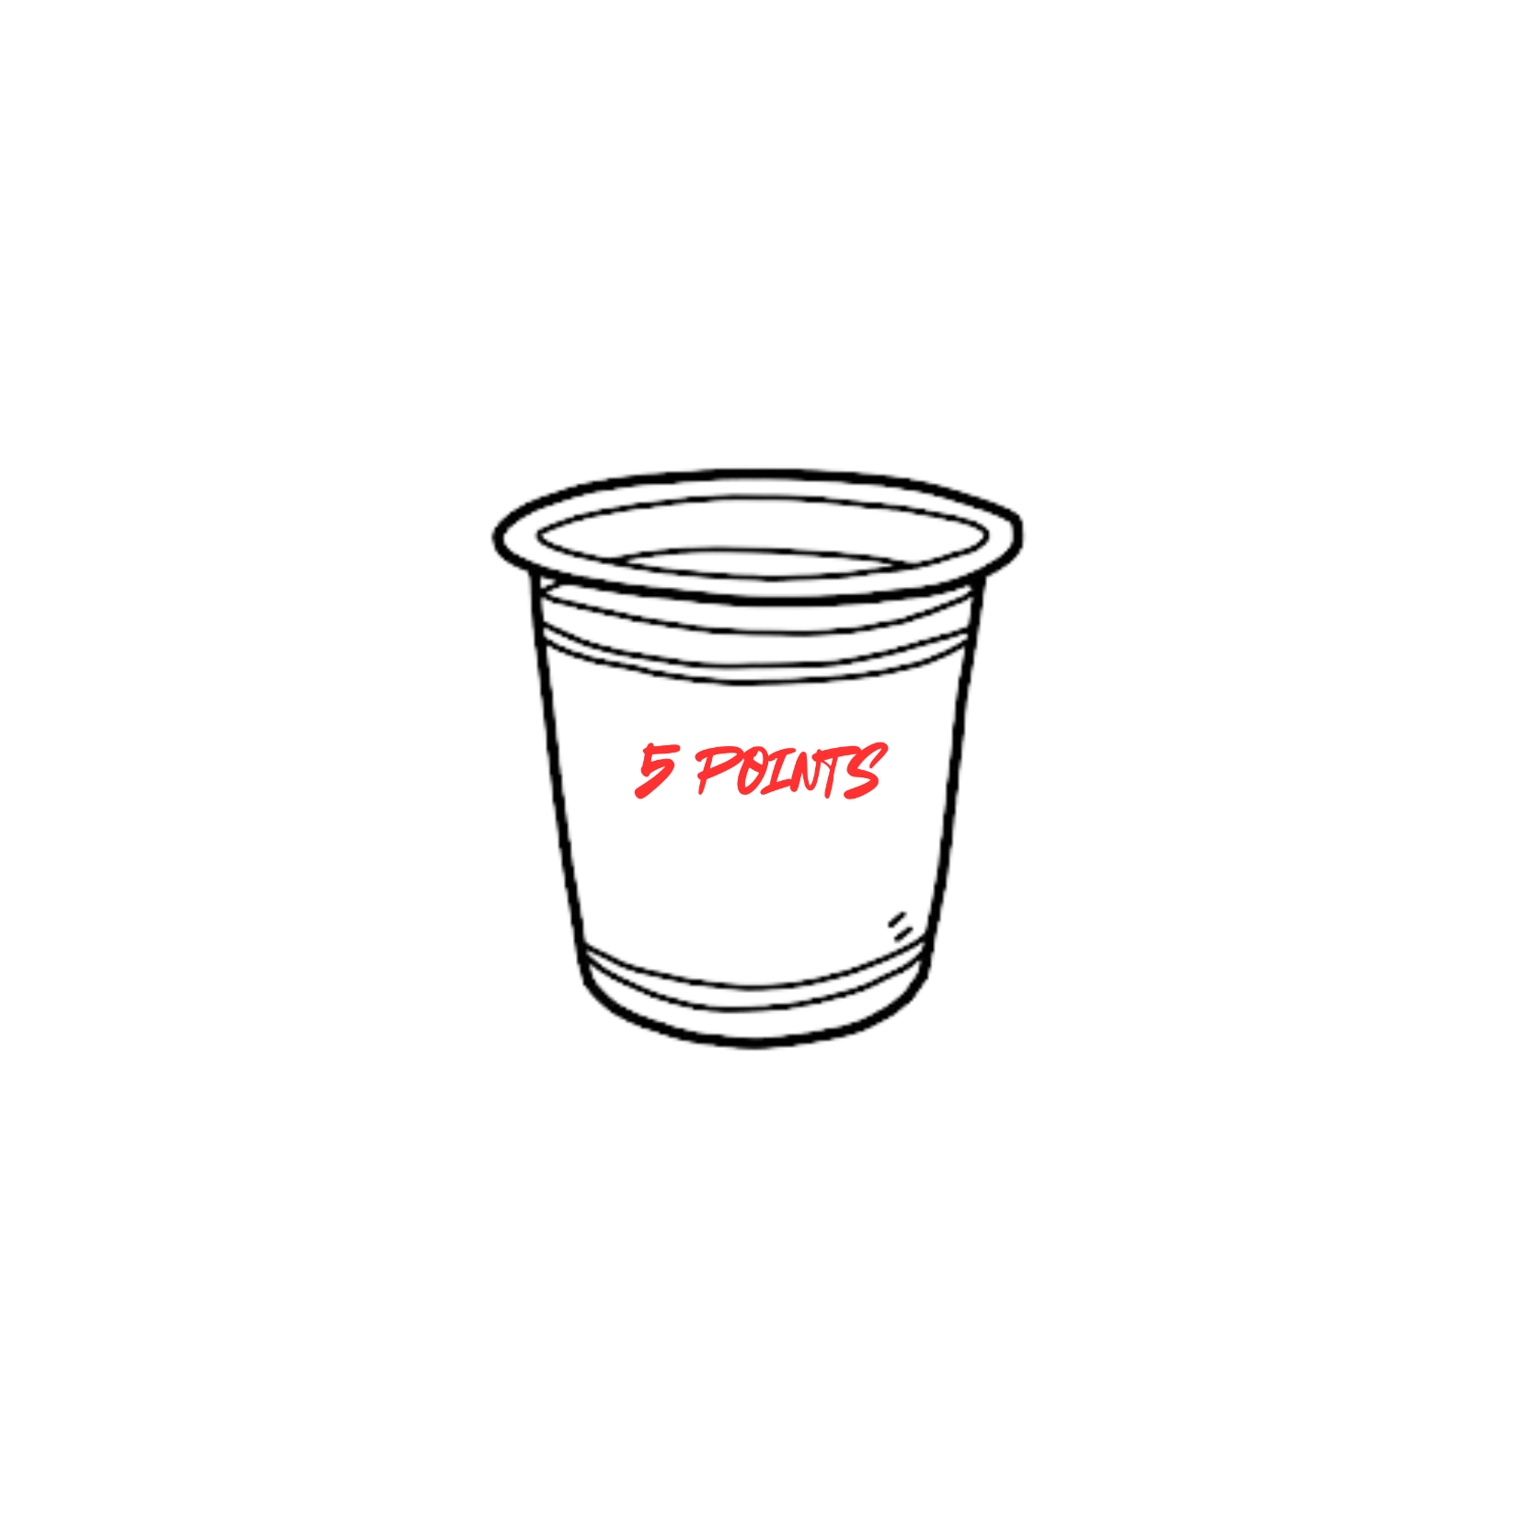
Let’s play… sow the seeds
How many points can you score with your seeds?

Slide 3
Let’s read… lets watch Matthew 13:1-8
Activity 1
https://www.youtube.com/watch?v=EBvclAMh49Q
Talk to the person next you about the meaning of the parable. Be prepared to feedback.

Slide 4
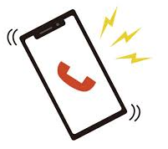
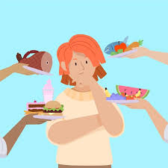
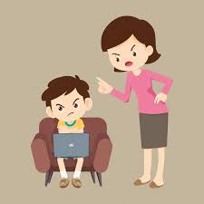
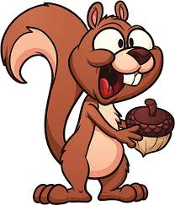
What distracts you from God’s word?
Activity 2
Listen to the following story.
1. Did the story make sense?
2. How put off were you by the distracting words?
3. What sort of things can distract us when we are reading or listening to God’s word?

Slide 5
The seeds on the path
Activity 2
Distractions are the seed on the path.
Satan does not want you to remember any scripture so he distracts you and steals God’s word from you.
How can we not be distracted?
2 Corinthians 10:5, Ephesian 6:16
How do these verses help us?

Slide 6
Are you a quitter?
Activity 3
1. What have you wanted to do and then given up quickly because it became hard, or too time consuming?
2. How hard do you revise for school tests? Is there a link between the harder you work and the better you get?
3. How do we get better knowledge and understanding of God’s word? Does it appear in our brains?
https://www.youtube.com/watch?v=Fo5y3Ydyhtc
Set the scene before playing the clip

Slide 7
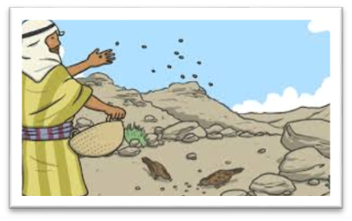
The seeds on the rocky soil
Activity 3
Rocky soil has no depth or nutrients things will not grow strong.
Unless you practice your faith everyday it will quickly die.
Jesus said: “I am the vine; you are the branches. If you remain in me and I in you, you will bear much fruit; apart from me you can do nothing.”
How does this quote help us understand about growing in faith?

Slide 8
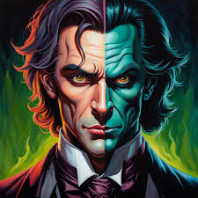
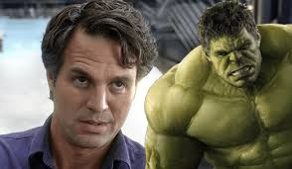
What would you rather be a saint or a sinner?
Activity 4
Anyone read the story Dr Jekyll and Mr Hyde? What’s the story?
The Bible says you cannot serve TWO masters, you will love one and hate the other…
1. What does the Bible say about the struggle with sin? Hebrews 12:1-2, Colossians 3:5-6, Psalm 19:13-14

Slide 9
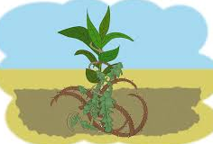
The seeds in the thorns
Activity 4
We will all struggle with sin in our life.
God does not want to stop us enjoying our life, but we can become consumed by things and they take over.
If our actions take us away from Jesus then we need to stop doing them!
But seek first his kingdom and his righteousness, and all these things will be given to you as well. Matt 6:33 How might this help us?

Slide 10
The fruitful person
Activity 5
Jesus was concerned with the health of our heart.
Not if it was pumping correctly; but was it open to God?
Read: Micah 6:8
1. How does a fruitful person behave? What is their life like?
2. How does a person bear fruit?

Slide 11
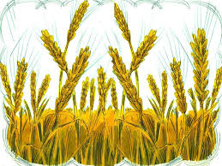
The seeds in the good soil
Activity 5
When we commit to Jesus and learn to spend time with Him, in prayer, study, worship and service, we WILL grow in faith. We will learn to rely Him and trust Him more and more.
When we use our talents and gifts for Jesus, we will help grow His kingdom and “bear fruit.” His kingdom will grow.

