Slide 1
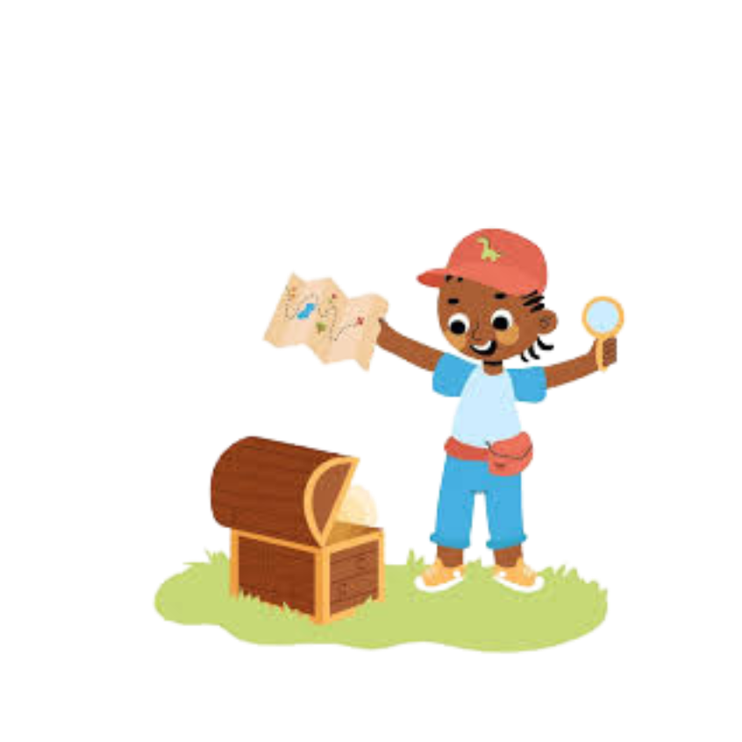
Searching@ Christmas

Slide 2
Let’s go looking for treasure?

Slide 3
Activity 1
https://www.youtube.com/watch?v=XWV4OpNgNbc
Why are they keen to find the presents? Is it a genuine reason ? Is there another reason why hey want to find the presents?
https://www.youtube.com/watch?v=fx6uRWSmo2g
Why did Chandler decide it was wrong to look at the presents? Is it better to know or have a surprise? What was Chandler’s response to his present?

Slide 4
Activity 2
He has made everything appropriate in its time. He has also set eternity in their heart, without the possibility that mankind will find out the work which God has done from the beginning even to the end. Ecclesiastes 3:11
What does this mean? It seems that God
wants us to search without ever finding Him.
Can that be right?
ONLY FAITH IN JESUS WILL REVEAL ETERNITY TO US

Slide 5
Activity 3
Read Mathew 2
1. Which two groups of people were searching for Jesus?
2. What were their reasons for searching?
Read Luke 2:8-13
3. What is the difference with the Shepherds search for Jesus?

Slide 6
Activity 4
https://www.youtube.com/watch?app=desktop&v=8Svwt4PzV90

Slide 7
In all the parables which character is God and which is us?
What do we learn about God from these parables?

Slide 8
Knowing that God is looking for us… He loves us and wants us back ( like a lost child!)
How do you feel?
Do you want to be found? Do you want to stay lost? Why?
Why might people not want to be found?

Slide 9
Whatever you’re searching for…only Jesus will satisfy your soul!

