Slide 1
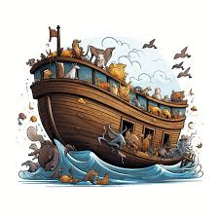
Noah –New Beginnings Genesis 7-9

Slide 2
Watch Cheesy video
Noah and the flood

Slide 3
In v 16 it says the “Lord shut him in.” What do you think that would have sounded and felt like?
2. What sort of other sounds do you think Noah and his family heard?
(loud seal being place on ark, all the animals making noise, the
sounds of other people banging on ark in mockery or to be saved).
3. Have you ever been on a cruise ship? Did you ever wonder if it
would actually float?
4. What is the longest time you have seen it rain? How does extended
periods of rain make you feel?

Slide 4
5. How long was Noah in the Ark? Remember months only
had 28 days as it was a lunar calendar (Ch 7:17,24, 8:3-14)
6. What must it have felt like to be cooped up in the ark
all that time? (Imagine being stuck on a boat with your
family for over a year with no one else!)
7. What promise did God make Noah? 6:18
Did Noah deserve to be the one God chose? Why?
9. Why did God choose Noah?

Slide 5
10. Can you see any connection between the story of Noah and Jesus?
11. How does God let Noah know that he will keep his promise and
not destroy the earth in the same way again?
12. How do we know today that God has rescued us from our sin?

