Slide 1
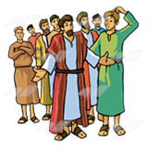
Joseph
Arrogant youth!
I want to kill him, I’m so jealous
Crazy dreamer
Dad’s favourite …Ggrrr

Slide 2
Joseph
Read Genesis 39:1-6
And watch
Joseph King of Dreams clip 1

Slide 3
1.Is Joseph’s behaviour surprising? Why didn’t he rebel or try to escape back home?
2. God does not help Joseph escape, but makes His presence known in other ways? What does this teach us about God in our own lives and personal situations?
3. What must have it been like living in exile, away from home? How would he have felt? Why do you think he needed to trust God so much?

Slide 4
Read Genesis 39:19- 40: 23
And/or watch
Joseph King of Dreams clip 2
What does 39:21-23 tell us about Joseph’s prison experience?
2. How did Joseph help others whilst in prison?
3. Was he right to tell the baker the truth even though it was bad news?
4. What can we learn from the Butler’s forgetfulness?
5. Look at ch 41:1. How long did he have to wait for release? Did God forget him?

Slide 5
Read Genesis 44:16-45:8
Joseph King of Dreams clip 3
1. How does the story end?
2. Why does Joseph forgive his brothers?
3. What does Joseph realise about his whole life?
4. Can you see any comparisons between Joseph and Jesus?

Slide 6
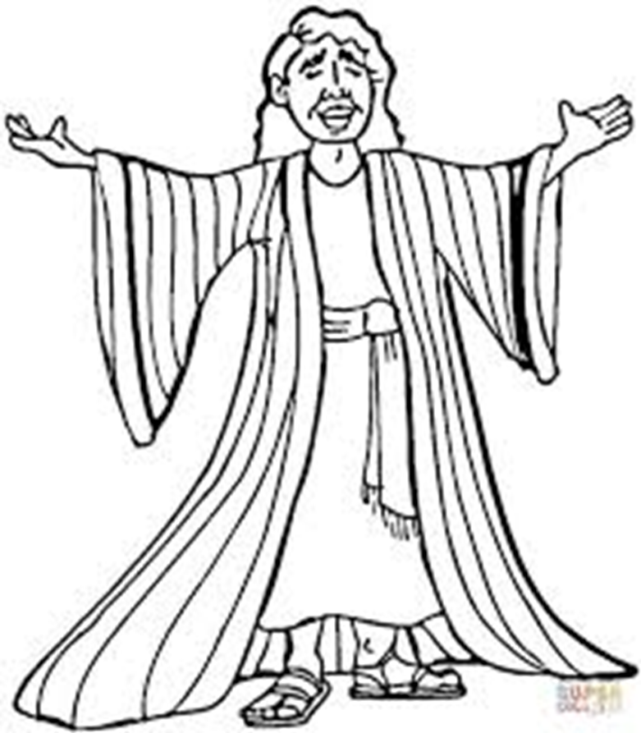
Joseph
The LORD was with Joseph
He IS with me too.

