Slide 1

Jacob: Deceiver deceived
online-stopwatch.com/chance-games/find-the-ball/

Slide 2

Read Genesis 29:15-30
And/or watch cheesy kids video
https://www.youtube.com/watch?v=E1EE4PorAlU

Slide 3
How would you describe the character of Laban? Where in the text do you see this?
What are the similarities between what Laban did and what Jacob did to deceive his father?
Look at v25-26. now compare it to Genesis 27:18-22.
Why do you think God allows this to happen to the one whom he has chosen?
Is it fair?

Slide 4
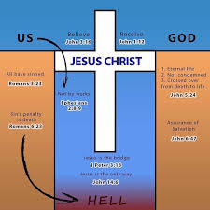
https://www.youtube.com/watch?v=xs8kEyZUUvM

Slide 5


Faith in Jesus saves us and connects us to God
As a Christian our actions still matter… we will be judged on how we live.
What does the Bible say about Judgement?
2 Corinthians 5:10
Romans 14:12-13
Revelation 20:11-15
What does it say about how we should behave?
Micah 6:8
Galatians 5:22-23
Mark 12:30-31

Slide 6

The Holy Spirit:
Challenges us
Teaches us
Corrects us
Warns us
Guides un to truth

Slide 7
