Slide 1

Adam and Eve:
The Fall
Genesis 3

Slide 2
Crisps or chocolate
Get up early or stay up late,
Weetabix or toast
Adidas or Nike
City or United
Reading a book or watching TV
Sport or music
Obedience to mum and dad or doing what friends want
Homework or Xbox
Vegetables or chips
Church on Sunday or a lie in
Following Jesus or following your own way.

Slide 3
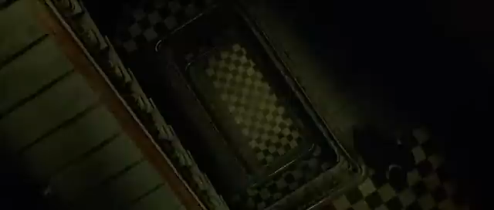

Slide 4
Let’s Read Genesis 3
Has anyone ever regretted a decision they made? Did you decide to do something without thinking of the consequences?
2. Why can making decision be so difficult?
3. Did Adam and Eve make a mistake in
this story? Why do you think so? What
did they do wrong?
What can we learn about humans from this story? What does it tell us about our decisions?

Slide 5
5.What does it tell us about God?
6. What do you think “knowledge of good and evil” means? How do you distinguish between those
two things in your own life?
7.READ v14-15 Can you see where God begins His plan to rescue humans? Who is the one who
will crush the serpent? How does he do this?

Slide 6


What should stop you making a bad choice?
How do I know what is bad?
What should I do if I am unclear about a decision I need to make?
Who can I speak to, to get WISE help?
How can I make certain my choices are good?
How can Jesus help me make good choices?

