Slide 1
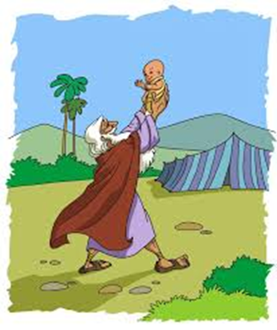
Abraham: Faithful not perfect
Stories in the life of Abram/Abraham

Slide 2
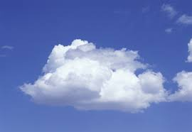
Would I lie to you?
A cloud weighs around a million tonnes
TRUE
A cloud typically has a volume of around 1km³ and a density of around 1.003kg per m³ – that's a density that’s around 0.4 per cent lower than the air surrounding it. ( that’s why it floats)

Slide 3
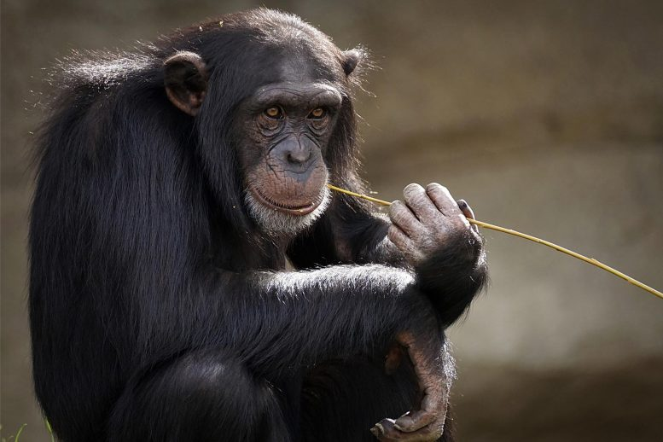
Chimps have more hair than humans
LIE
Humans have between two and five million hair follicles spread around their bodies, which is about the same number as other primates. Our hair is just much less coarse and less visible.

Slide 4
Our solar system has a wall.
TRUE
The heliopause – the region of space in which solar wind isn’t hot enough to push back the wind of particles coming from distant stars – is often considered the “boundary wall” of the Solar System and interstellar space.

Slide 5
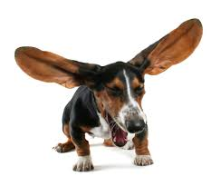
Animals can be allergic to humans.
True
Animals can be allergic to our dead skin cells – dander. These allergic reactions can be just like ours, too, including breathing difficulties and skin irritation.

Slide 6
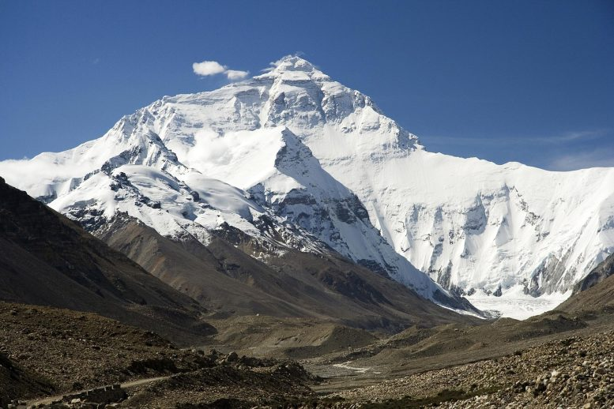
Mount Everest is the world’s highest mountain
Maybe
At 29,035 feet (8,850 meters) from its base to its peak Mount Everest is generally considered to be the world’s highest mountain. But that depends on your definition of “highest.”
If you define “highest” as the tallest mountain from base to peak, then the award for “highest mountain” must go to Hawaii’s Mauna Kea: it measures over 32,808 feet (10,000 meters) from its base in the Pacific Ocean to its peak, which is almost a mile taller than Everest.
If you define highest as “closest to the moon,” the honour must go to Mount Chimborazo in Ecuador. As it is closer to the equator and sits on a bulge in the earth’s surface.

Slide 7
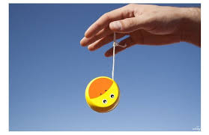
You can yo-yo in space.
True
In 2012, NASA astronaut Don Pettit to
took a yo-yo on board the International Space Station and demonstrated several tricks. It works because a yo-yo mainly relies on the laws of conservation of angular momentum to perform tricks, which, provided you keep the string taut, apply in microgravity too.

Slide 8
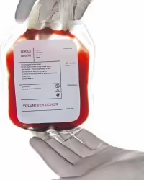
Deoxygenated blood is blue
LIE
Everybody has veins snaking up and down their bodies, and those veins are blue.
But no! Once your blood has stopped by your lungs and picked up a load of oxygen it's bright red blood. Once it's circulated through your body, it returns and the blood has turned dark red and it goes to take another pass through the heart.
Basically, the veins are blue thanks to a trick of the light, not the colour of what's inside them.

Slide 9
Read Genesis 12: 10-20
1. What mistake did Abram/Abraham make?
2. Why was it a mistake?
3. What was the impact on Pharoah?
4. In what way was God faithful despite Abram’s sin?
5. What are the kind of errors of judgement young
(new to faith) Christians might make?
6. What should you do when you make a mistake (sin)? Look up 1 John 1:9

Slide 10
READ Genesis 15:18 - 16:10
1. What does the Lord promise Abram? Why would this have been a strange promise to him and his wife Sarai?
2. How do Abram and Sarai try to make God’s promise happen?
3. Why do they do this?
4. Why is this another example of not trusting God?
5. What problems does it cause?

Slide 11
READ Genesis 22:1-19
1. How does Abraham display great faith?
2. How is his faith and obedience rewarded? v17-18
3. How do we know Abraham had great faith in this story? How do we know he still believed in God’s promise?

