Slide 1
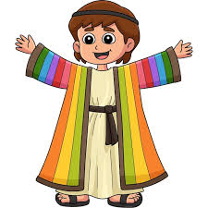
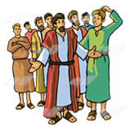
Joseph
Arrogant youth!
I want to kill him, I’m so jealous
Crazy dreamer
Dad’s favourite …Ggrrr

Slide 2
Joseph
https://www.youtube.com/watch?v=xp4Fym1KImY
If a movie or musical was made about you and your family, what would be a funny story/experience that would make for a good scene? What would be a serious one?

Slide 3
Read Genesis 37:1-4
What do we learn about Joseph and his brothers from
these verses?
Have you ever faced jealousy of been favoured? What did
it feel like?
3. Does Joseph’s commitment to his father and his family
responsibilities show him in a good or bad light? (He reports
to his father the poor behaviour of his brothers.)
4. Is it better to be truthful and honest or maintain positive
relationships with friends and family?

Slide 4
READ Genesis 37:25-11
1. Joseph shares his dreams, that God has given him. What
was the reaction of his brothers and his father?
2. Why do you think they reacted this way?
3. Should we remain quiet, if we know the truth, even if
people won’t like it?
4. Could Joseph have managed the situation differently?
Why didn’t he?

Slide 5
Read Genesis 37:16-36
https://www.youtube.com/watch?v=hNn1iw2N8No
(song: one more angel in heaven)
On the printed sheet, highlight the laws of God you think are broken in this passage.
Feedback how many, what are they?
1. What can we learn about the impact of Joseph’s lack of wisdom in how he shared his dreams?
2. Is Reuben less guilty than the others? v 21-22 Why?

Slide 6
If any of you lacks wisdom, you should ask God, who gives generously to all without finding fault, and it will be given to you.
James 1:5
Stick it in your Bible or somewhere where you will see it!

Slide 7
Joseph

