Slide 1
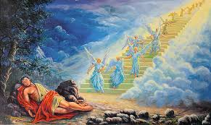
Jacob: Promises promises
Let’s play: Stand up sit down!
You promised to tidy your room, but you didn’t
You promised to wash your stuff up, but you didn’t
You promised to do your homework, but you didn’t
You promised to keep a secret for a friend, but you told!
You disagreed with your parents because you thought you knew best!
You refused to do something that you knew you should do, but were just being stubborn!

Slide 2
7. Have your parents ever promised something and then broken that
promise?
8. Have you been excited by the prospect of something ( a present/ a
day out/ a friend coming over) yet been disappointed by it?
9. Have you ever missed out on something really good because you
chose something else, you thought was better (but it wasn’t)?
10. Have you been promised something and are still waiting in hope for
it to happen?
Sit down if you don’t think it will ever happen!

Slide 3
Genesis 28:10-22
Read together and/or watch Cheesy video
https://www.youtube.com/watch?v=gxBulcHFBTg

Slide 4
Highlight God’s promises in one colour and highlight Jacob’s promise in another
1. Compare the promises. Whose promises are greater?
2. Who has put conditions on their promises?

Slide 5
Does God always keep His promises? How do you know?
In what ways do we behave like Jacob?
Why is this the wrong approach to God?

Slide 6
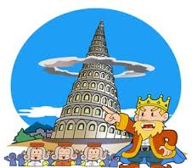
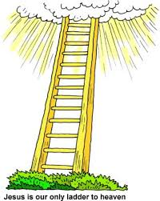
Optional activity
Look up Genesis 11: 1-9 and Ch28:12-14
What is the difference between these two stories?
What does it teach about Human effort to reach god and God’s desire to reach down to us?

