Slide 1
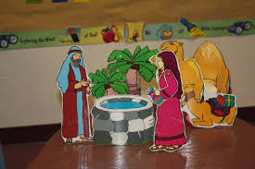
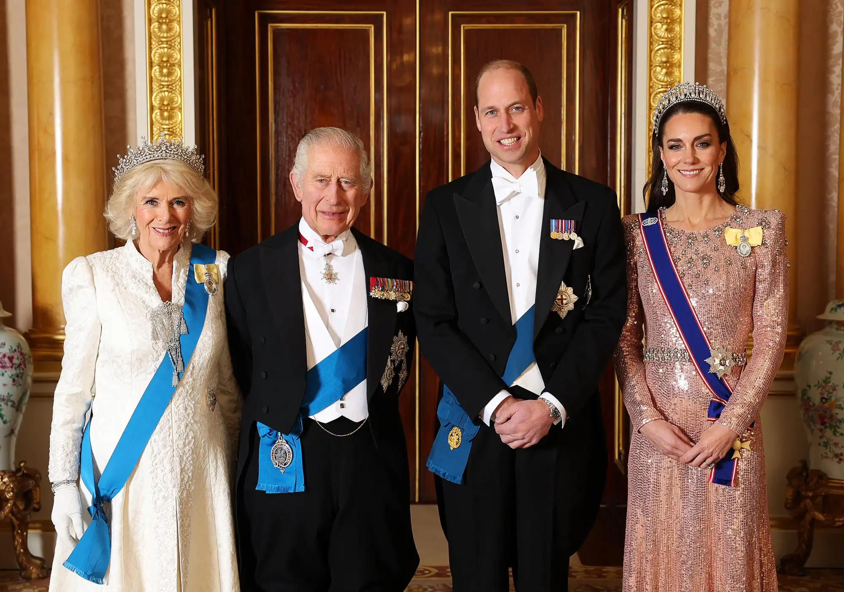
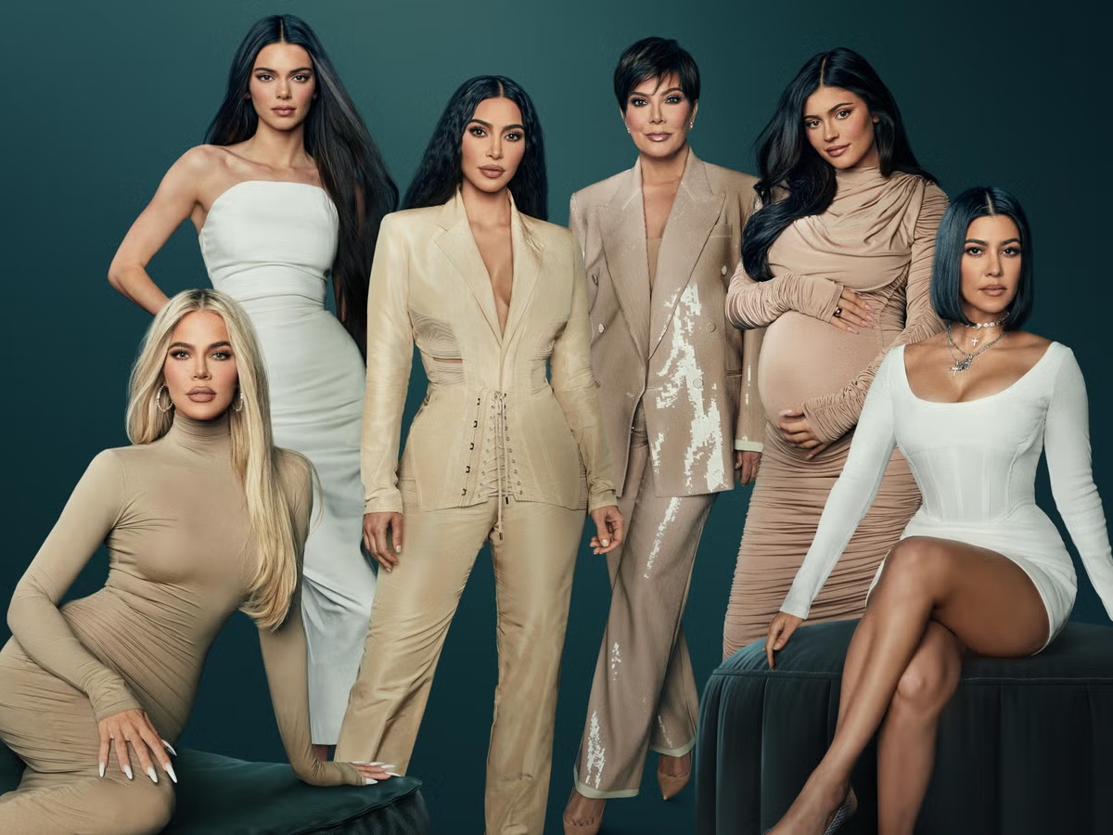
Isaac and Rebekah: Happy families?
The Royal family
The Kardashian family

Slide 2
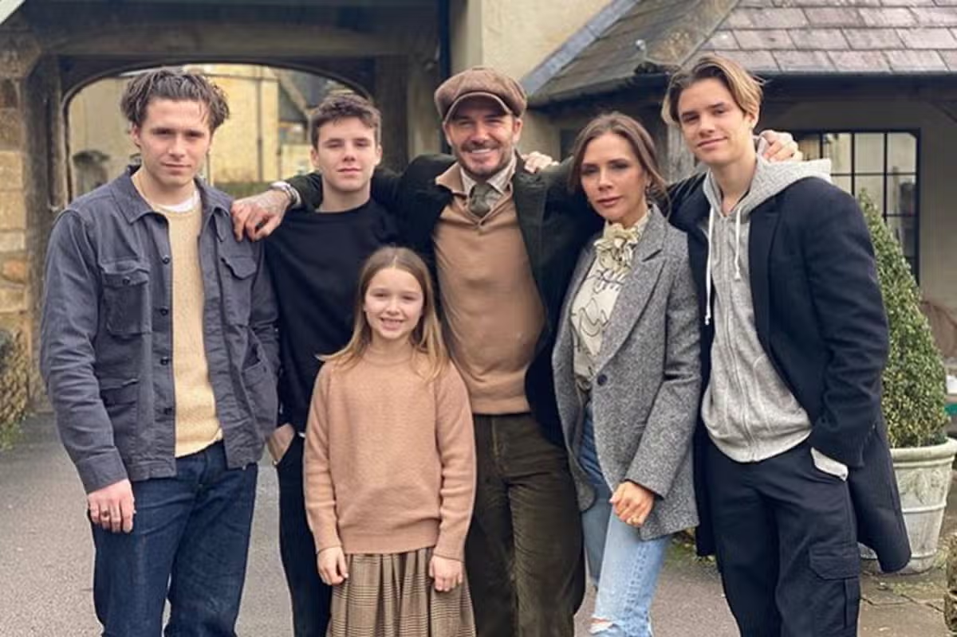
The Beckham family
The Simpson family

Slide 3
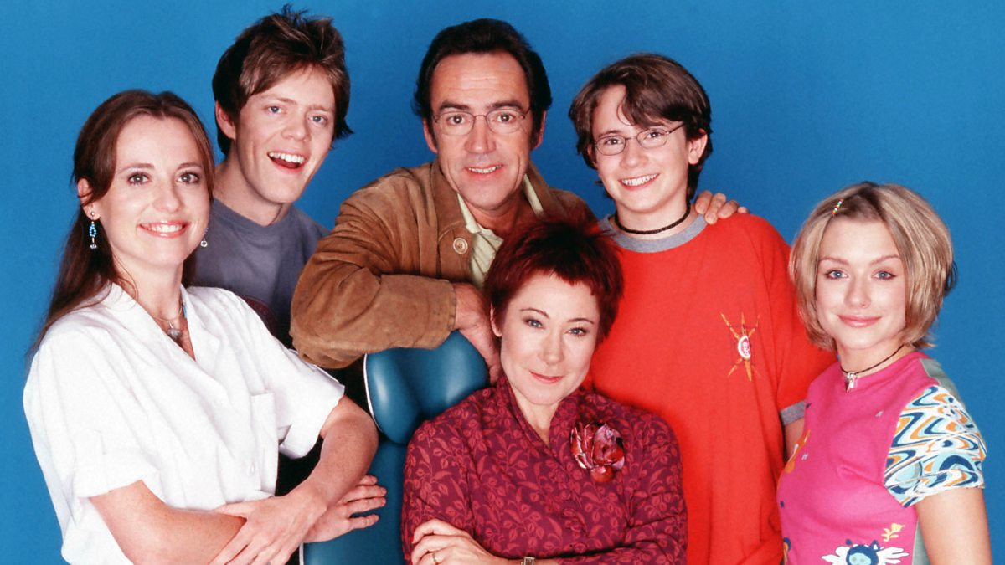
Modern family
“My” family

Slide 4
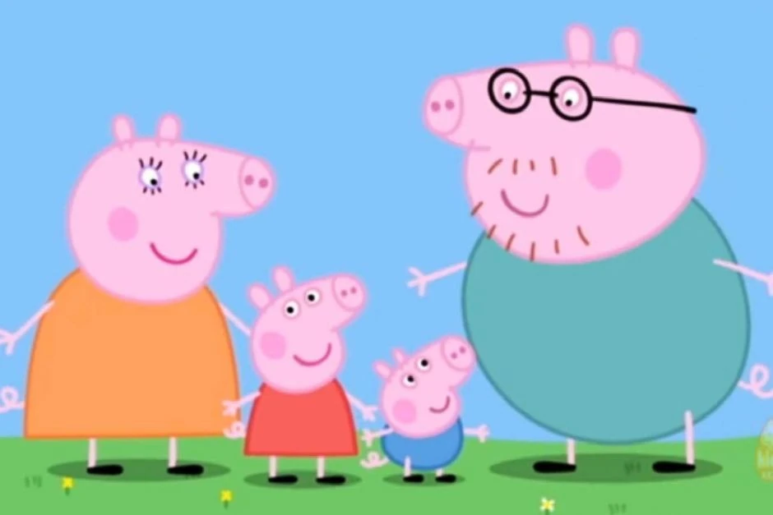
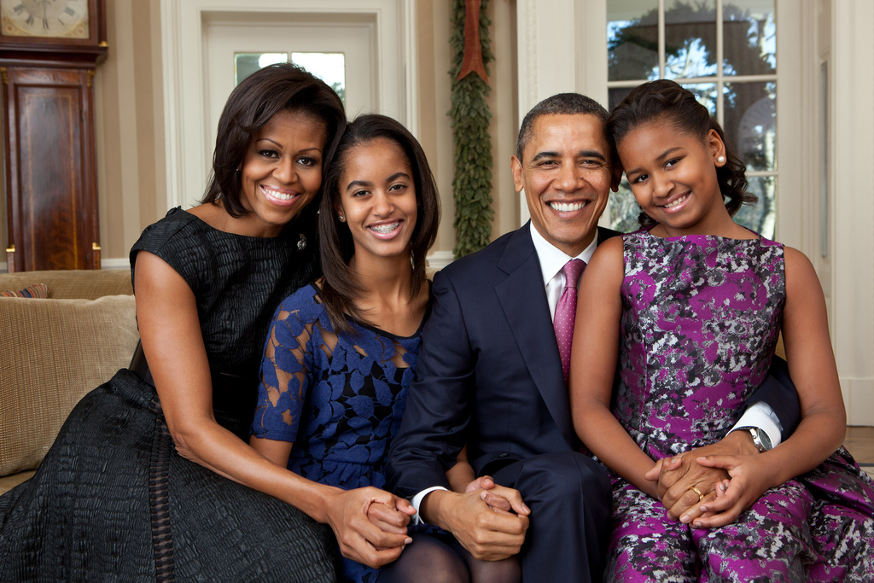
Peppa Pig family
The Obama family

Slide 5
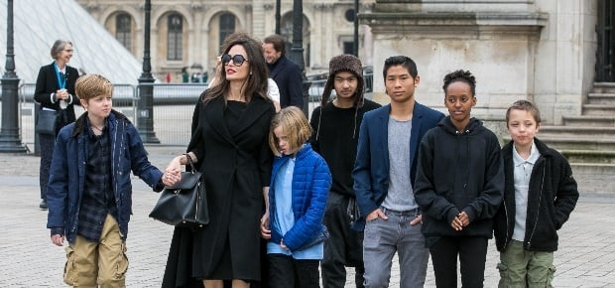
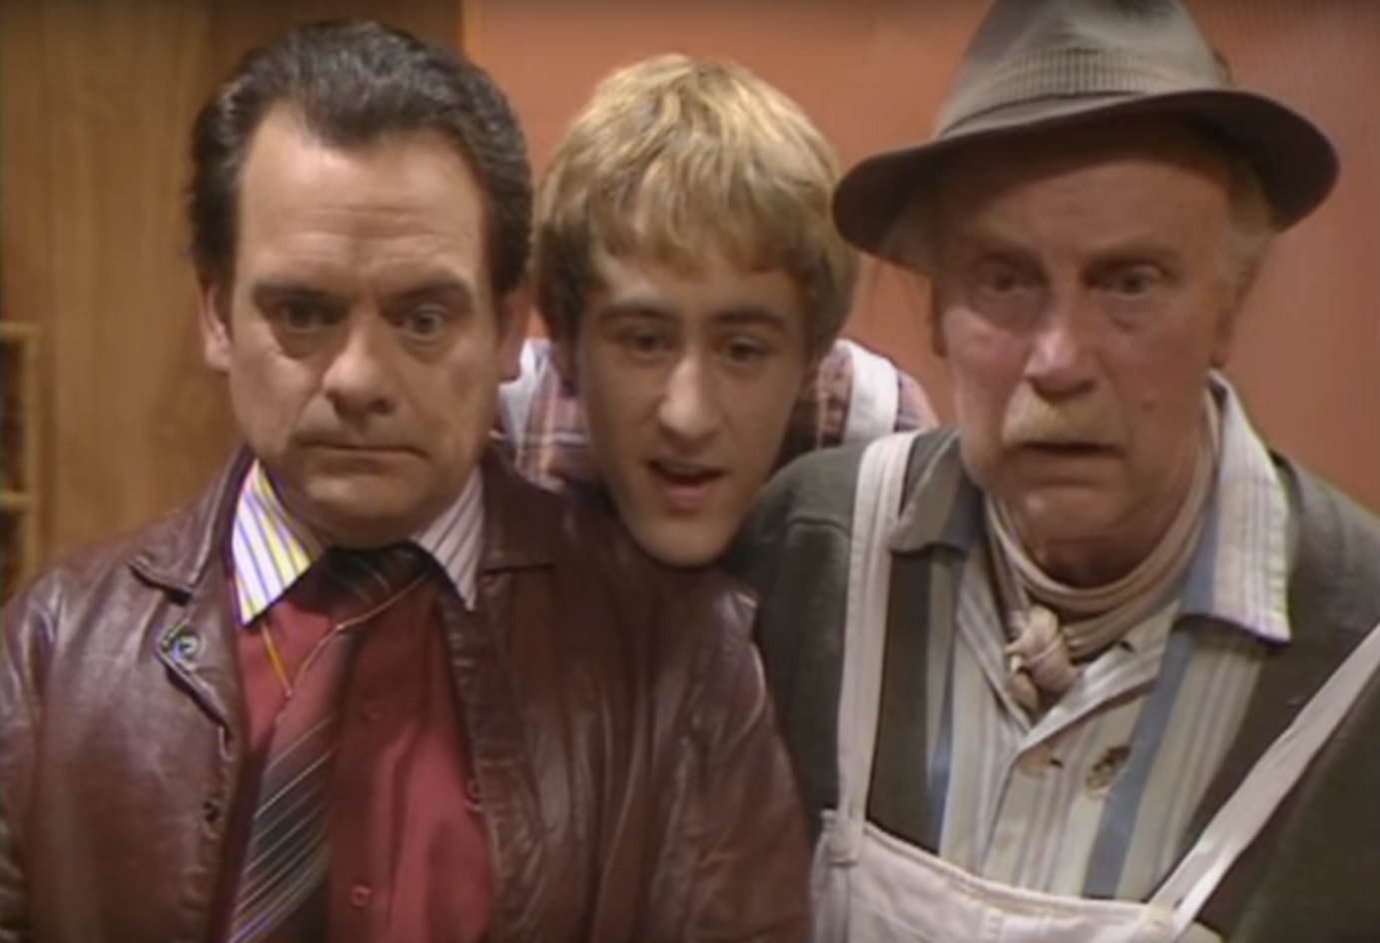
Angelina Jolie and family
What have all the families got in common?
How are they different?
Are they like your family?
What do you think makes a family?
The Trotter family

Slide 6
Cheaper by the Dozen family chaos

Slide 7
God chooses a wife for Isaac!
Cheesy Sunday school cartoon
or
Read Genesis24:1-66
( could take hours!)

Slide 8
1. Why do you think Abraham wanted Isaac to marry someone from “back home” and not a local girl?
2. Does it seem weird that Abraham’ servant is tasked with choosing a wife for Isaac? What problems do you foresee in this?
3. How is God involved in this decision? v7, v12ff
4. Does God still get involved in how we choose our husbands or wives? Is it important?

Slide 9
Watch cheesy video
OR
Read
Genesis
25:19-34
And
Genesis
27:1-40

Slide 10
1. If parents have favourite children why
can this lead to problems?
2. What problems did it cause for Isaac
and Rebekah?
3. Siblings often fight, but what was so
wrong about Jacob’s attitude to Esau?
4. How did Esau disrespect his family?

Slide 11
Our families are not perfect…
But God still blesses us despite
our failings!
What can I do to in my family that will honour God?
Obey my parents… it brings a blessing from God!
Love and support my siblings, don’t frustrate them.
Let my parents teach me about Jesus. Follow their example .

