Slide 1

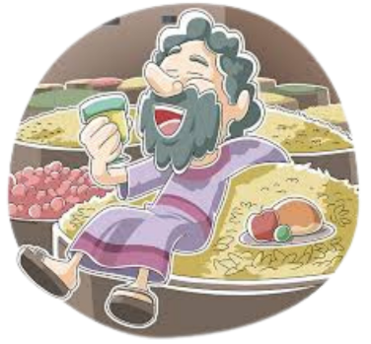
The parable of the Rich Fool
Luke 12:13-21
A study about greed.

Slide 2
Money race /Rice relay

Slide 3
Let’s watch…
Activity 1
https://www.youtube.com/watch?v=RnvPnQbcny8
How is greed seductive?
2. Why is it easy to become greedy?
3. What is the correct attitude to have towards “stuff”
and wealth?
4. What do 1 Tim6:9 and Hebrews 13:5 teach about greed?

Slide 4
Luke 12
Activity 2
v 1-12 v 12-21 v 22-34 v35-48 v 49-53 v54-59
Guard against hypocrisy and greed. Do not fear death, be prepared to stand up for Jesus. Get your priorities right.
A man asks Jesus to help him with a money problem. Jesus tells a parable about greed!
Jesus teaches us not to rely on money but to have faith in him and His father in Heaven, who provides for those who follow Him.
Be prepared for the return of the king. Jesus teaches that our priority must be on doing God’s will
Jesus teaches that there will be a division between believers and non believers. Even within families. Different priorities!
Judgement is coming. We need to recognize it and act accordingly so we are on the right side!
Jesus has just spoken about Getting priorities right and putting God first…. Then this man who clearly has not been listening asks….

Slide 5
Luke 12:13-21
Activity 2
1. If you could ask Jesus anything, what would it be?
2. The man in the story has Jesus’ full attention and can ask
Him anything at all, why does he ask Jesus to sort out his
financial issue?
3. Look a t Jesus’ response to the man… “Man, who appointed
me a judge or an arbiter between you?” Watch out! Be on your guard against all kinds of greed; life does not consist in an abundance of possessions.” What does it reveal about Jesus’ attitude to money and greed?
4. How does Greed distract us from God and Jesus?

Slide 6
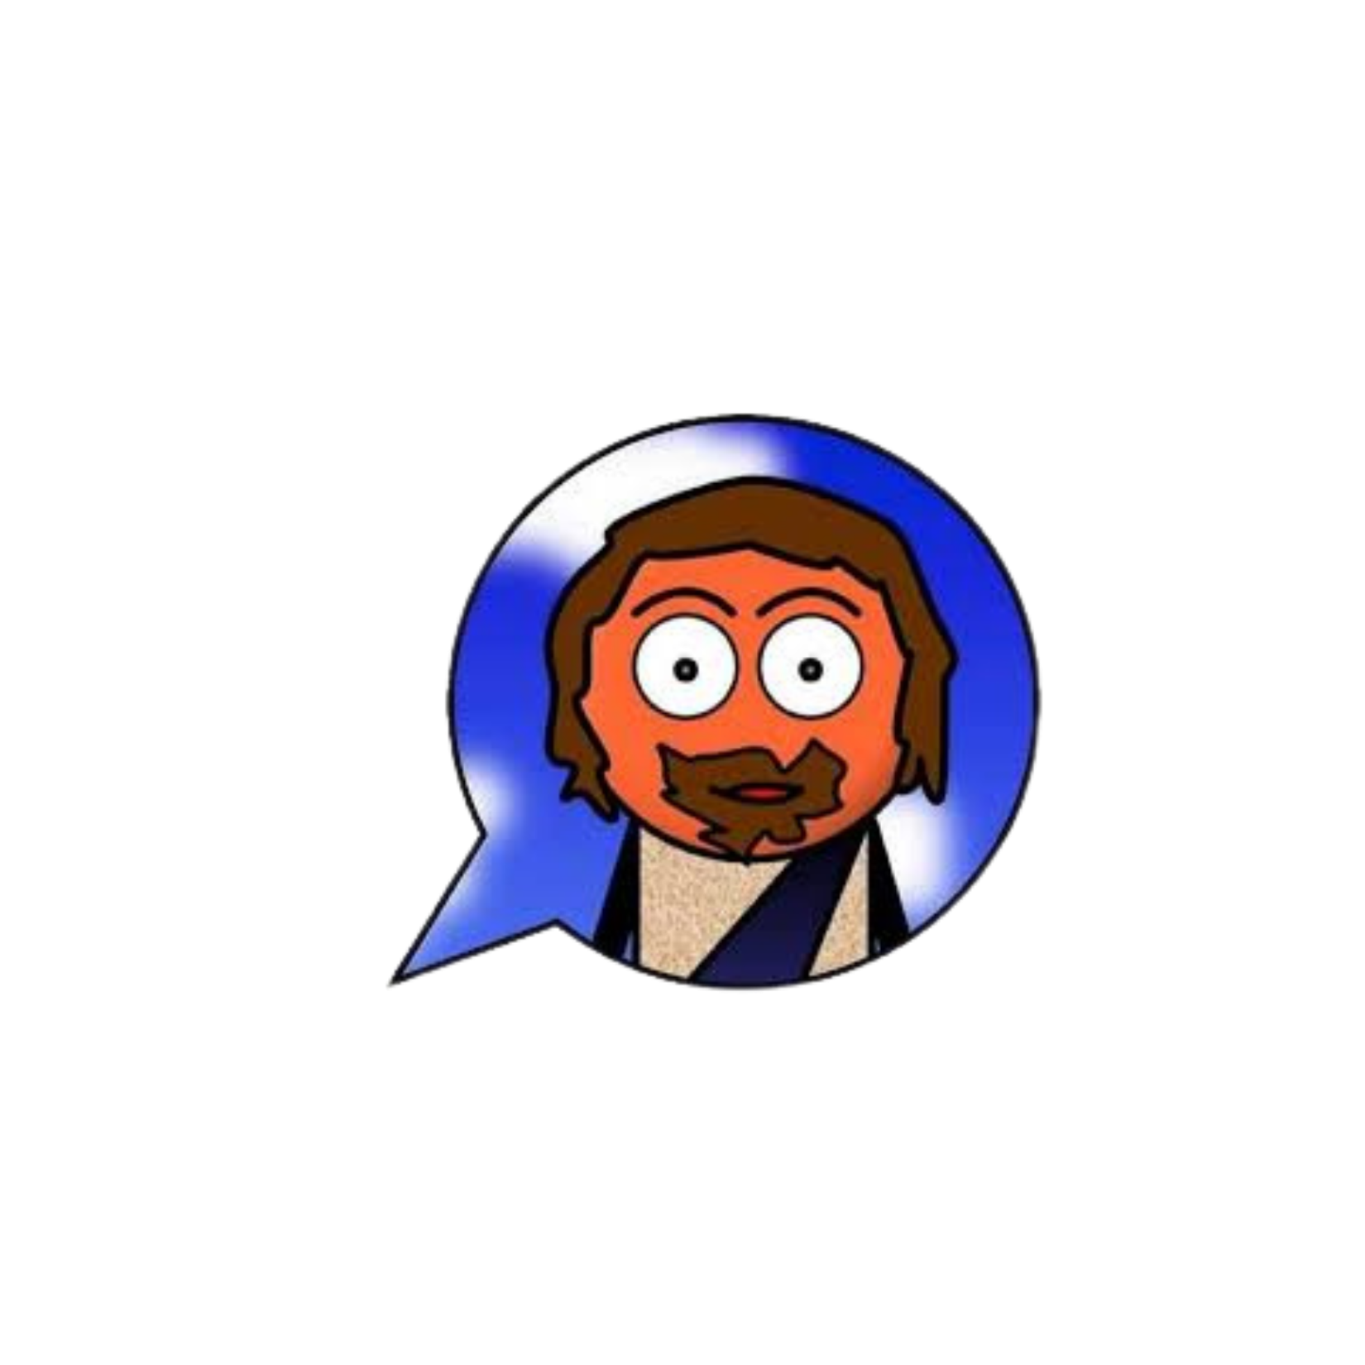
What do you think of the parable’s ending?
Activity 3
Discuss your feelings and thoughts about it with the person next to you. Be prepared to feedback ideas.

Slide 7
There are two key ideas we need to see!
Activity 3
God is sovereign (He’s in control)
When we make plans for our money we must remember God loves His people to be generous!

Slide 8

Activity 3
Bible verse look up!
Luke 6:38,
2 Corinthians 9:6-8,
Proverbs 22:9 ,
1 Timothy 6:17-18,
Matthew 6:24
What do these verses teach about attitude to money?
How does this affect me?

Slide 9
And finally…
For a few moments… sit quietly and think:
How can I become less greedy? What are the ways we are greedy in life?
How can I become more generous?

