Slide 1
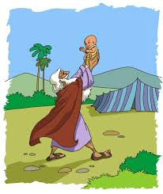
Abraham A call and a promise

Slide 2
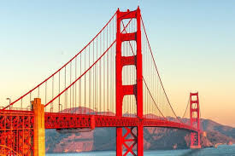
A famous landmark

Slide 3
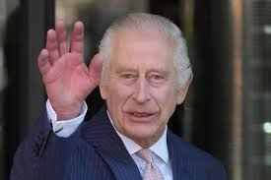
A famous person

Slide 4
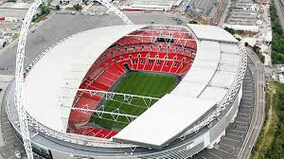
A famous landmark

Slide 5
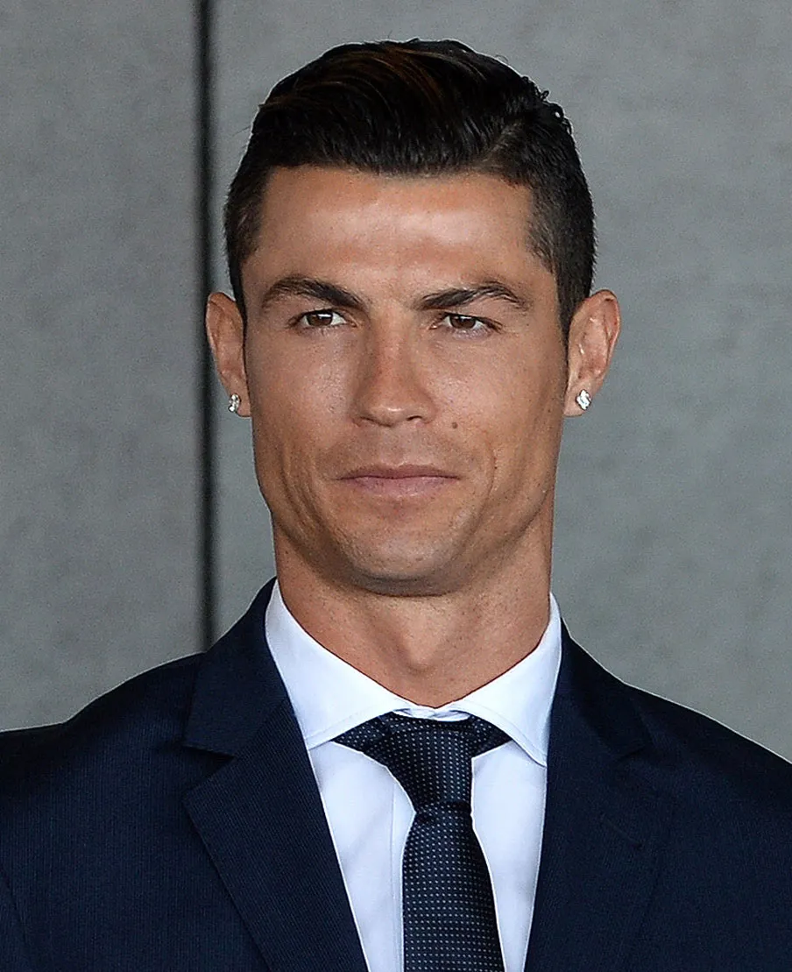
A famous person

Slide 6
READ Genesis 17:1-2
1. How do you think Abraham felt when God
appeared to him at the age of 99?
2. What do you think it means to be almighty?
3. What do you think a covenant is?
In what ways can we “walk before God faithfully” in our daily lives as teenagers? Why is it hard to do so?

Slide 7
Read Genesis 17:3-7
5. Why might Abraham have struggled to believe God
when He said “for I have made you a father of many
nations.”
6. Why do you think God changed Abram’s name to Abraham?
7. How does this covenant with Abraham reflect God’s inclusive
love for all nations?

Slide 8
Read Genesis 17:15-16
What do you think Sarah might have felt upon hearing about God’s
plan for her?
9. In what ways can we be sceptical like Sarah, not believing God has
almighty power to do anything?
10. Anyone know how Abraham tried to manipulate God in to keeping
His promise?
11. How does God demonstrate He is able to keep His promises?

